Slide 1
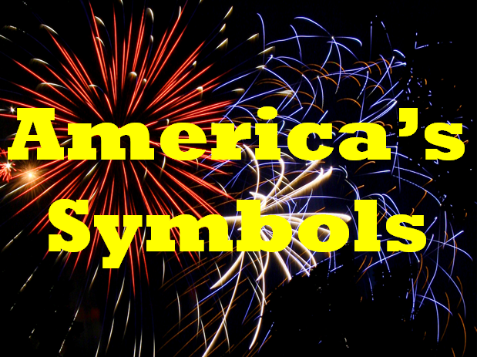
Wagner

Slide 2

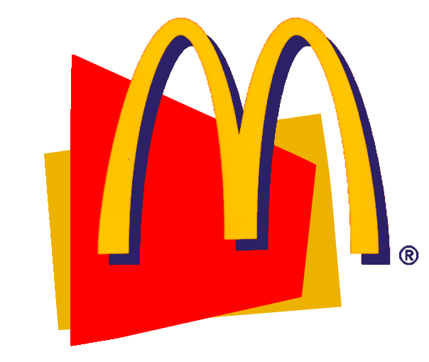

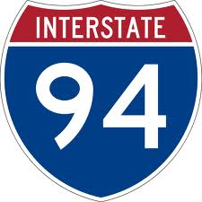



Symbols are things that stand for something else.
Notes:
Symbols

Slide 3

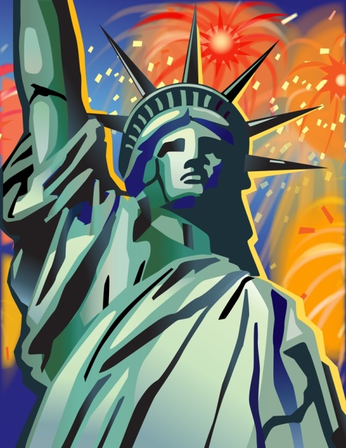

Slide 4


Slide 5

1
2
3
4
5
6
7
8
9
10
11
12
13
The 13 stripes stand for the original 13 colonies.
The 50 stars stand for the 50 states.

Slide 6

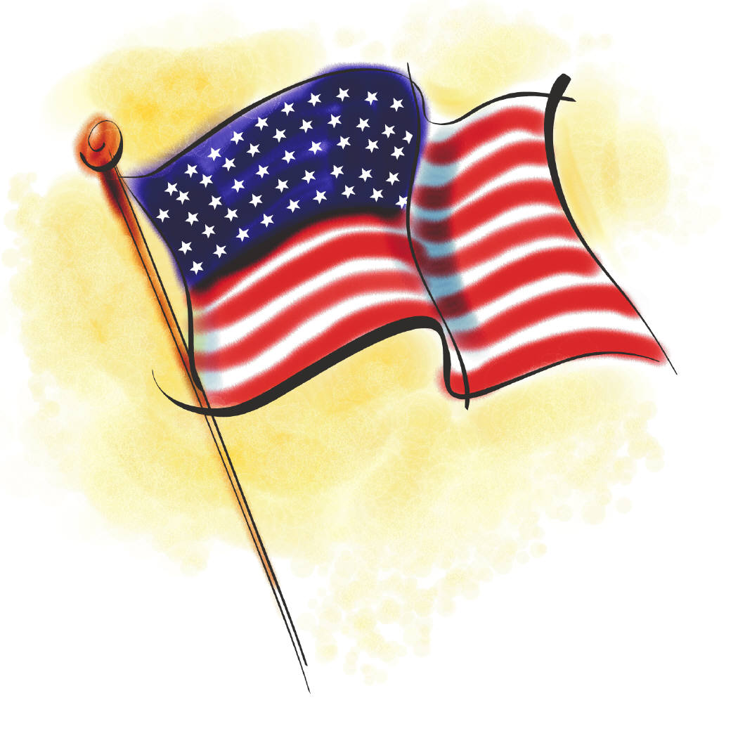
Stars and Stripes
Old Glory
The Star Spangled Banner
The Red, White, & Blue

Slide 7

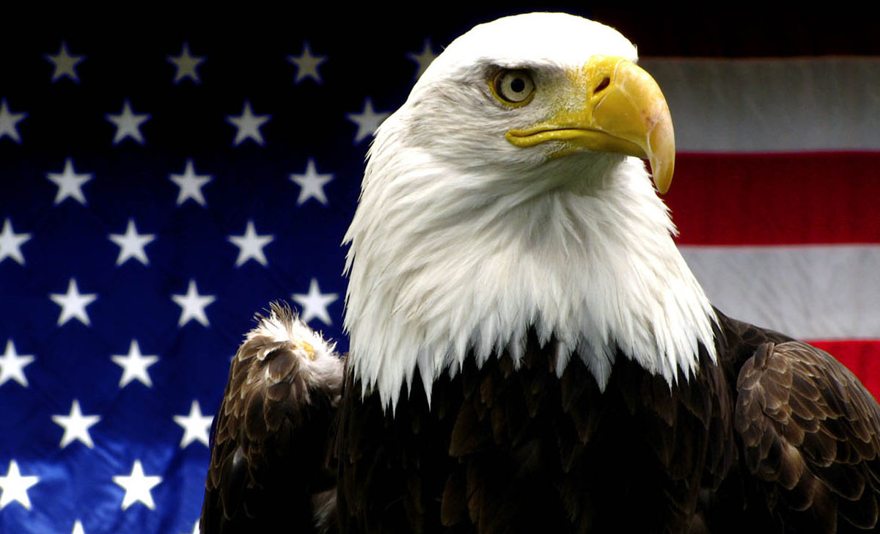

Slide 8
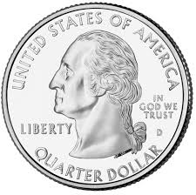
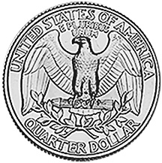
The Eagle is a good symbol for America!
  Eagles live a long time.
  Eagles are strong.
  Eagles look majestic.
  Eagles live in America.
  Eagles fly high.
  Eagles are free.
Did you know the Eagle is on the back of the quarter?

Slide 9

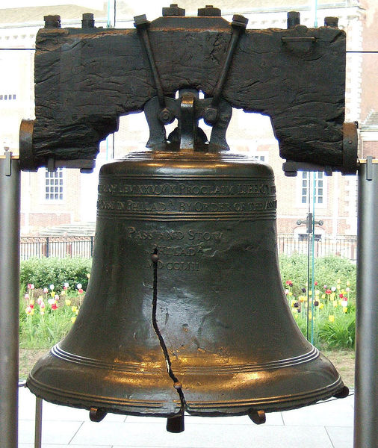

Slide 10
The Liberty Bell stands for freedom!
The Liberty Bell:
  Built in 1752
  The bell rung at the first reading of the
  Declaration of Independence.
  Hangs in Independence Hall in Pennsylvania.
  Cracked in 1835

Slide 11

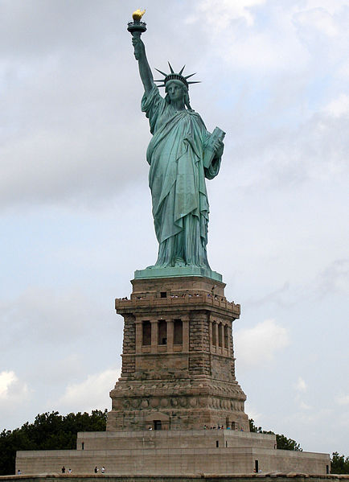

Slide 12
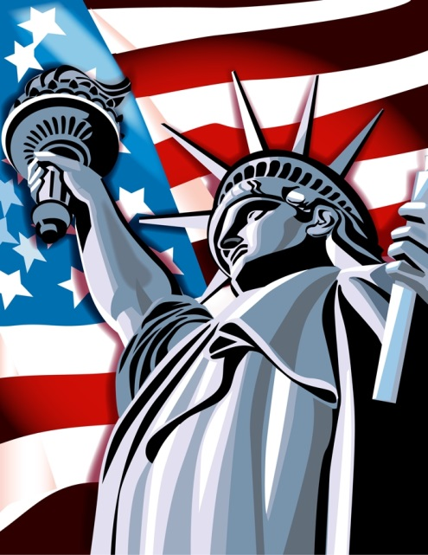
The Statue of Liberty stands for freedom!
Did you know?
  It was a gift from France.
  Statue of Liberty is on an island in New York City.
  Statue is 151 feet tall.
  Lady Liberty is holding a torch & a tablet.
  The Statue of Liberty was a symbol of welcome and freedom to immigrants.

Slide 13

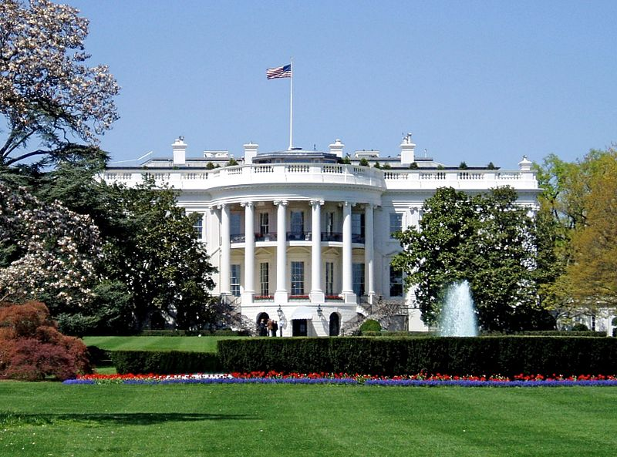

Slide 14
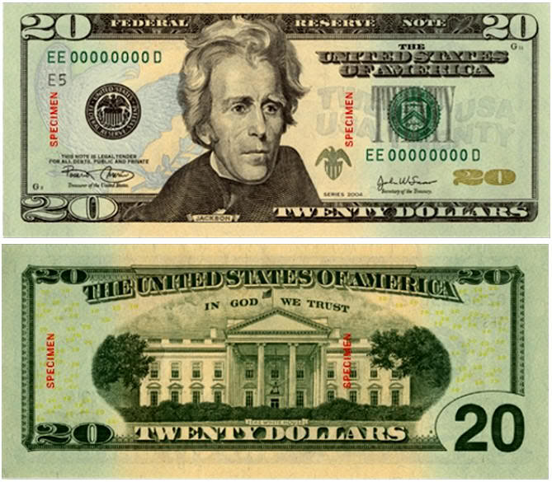
Where the President lives and works!
Did you know?
  It is in Washington D.C.
  Every President except George Washington has lived in the White House.
  There are 132 rooms in the White House.
  There is a picture of it on the $20 bill.

