Slide 1
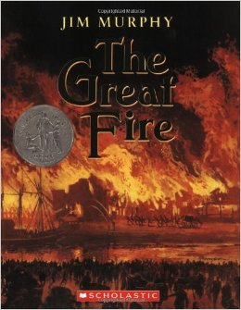
Close Reading
Exemplar Text

Slide 2
Learning Target
By the end of today’s class, you will be able to say…
I can explain how specific aspects of a text reveal the author’s purpose.

Slide 3
What Strategy Will We Use To Reach Our Learning Target?
Close Reading
I can explain how specific aspects
of a text reveal the author’s purpose.

Slide 4
What is Close Reading?
Multiple, strategic readings
of the same text
for a specific purpose.
The specific purpose is my learning target!!!
I can explain how specific aspects
of a text reveal the author’s purpose.

Slide 5
So Close Reading Is…
Multiple, strategic readings
of the same text
so that I can explain how specific aspects reveal the author’s purpose.
It always comes back to that learning target…
I can explain how specific aspects
of a text reveal the author’s purpose.

Slide 6
Time To Read!
Excerpt from
Chapter 1
“A City Ready To Burn”
of
The Great Fire
by Jim Murphy
Excerpt p. 18-19
PDF Available
(vanburenela.com)
“Excerpt” means that I don’t have to read the whole book.
I can explain how specific aspects
of a text reveal the author’s purpose.

Slide 7
Time To Read!
1st Read:
Follow along as I read an excerpt from The Great Fire by Jim Murphy.
Listen for 1 fact that you will be able to share with a partner.
Excerpt p. 18-19
PDF Available
(vanburenela.com)
I can explain how specific aspects
of a text reveal the author’s purpose.

Slide 8
Share Your Fact…
Think - Pair - Share
Take turns sharing a fact from the reading.
How was your fact connected to your partner’s fact?
I can explain how specific aspects
of a text reveal the author’s purpose.

Slide 9
Time To Re-Read!
Why do I have to read this again?
I can explain how specific aspects
of a text reveal the author’s purpose.

Slide 10
Because Close Reading Is…
Multiple, strategic readings
of the same text-
Oh Yeah!
So that I can explain how specific aspects reveal the author’s purpose!
I can explain how specific aspects
of a text reveal the author’s purpose.

Slide 11
Time To Read!
2nd Read:
Let’s read this together using oral cloze.
As we read, underline each specific fact that we encounter.
I can explain how specific aspects
of a text reveal the author’s purpose.

Slide 12
Fact Share
Small Groups
Compare all of the facts identified by your group members.
What do you notice about the facts?
Why did the author choose to include these specific facts?
I can explain how specific aspects
of a text reveal the author’s purpose.

Slide 13
Whole Group Fact Share
Whole Group
What did groups notice about the facts?
Why do you think the author included these specific facts?
I can explain how specific aspects
of a text reveal the author’s purpose.

Slide 14
Time To Read Again!
3rd Read:
Read this text independently, this time, underline any word that you feel signifies or relates to fire.
I can explain how specific aspects
of a text reveal the author’s purpose.

Slide 15
Word Choice Share
Small Groups
What words stuck out for you?
Did your group find different words?
I can explain how specific aspects
of a text reveal the author’s purpose.

Slide 16
Read It Again
Look for 1 sentence that sums up what the author wants the audience to realize about Chicago in 1871.
What is Jim Murphy’s purpose for writing this chapter?
What facts / words did he include to reveal his purpose to us?
Use the graphic organizer to record your findings.
I can explain how specific aspects
of a text reveal the author’s purpose.

Slide 17
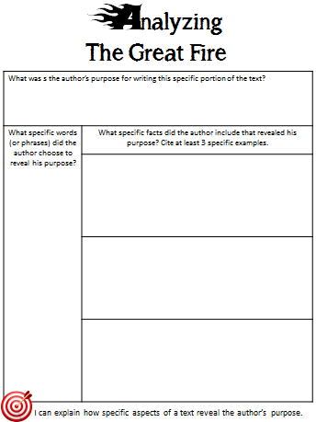
Personal Reflection
Did you meet the learning target for this task?
How do you know?
What will you do in order to figure out the author’s purpose for a different text?
I’m going to read closely…
I can explain how specific aspects
of a text reveal the author’s purpose.

