Slide 1
Discussions For Engagement
Michelle Wagner
Join the discussion!
What is one strategy that you use to engage students?
http://today.io/1j7b5

Slide 2
You Matter…

Slide 3
Idea Wave
Choose one word that describes the impact of a teacher.

Slide 4
Engagement
What does engagement look like in a classroom?
What are your favorite ways to engage students?
What are stops students from
being engaged?

Slide 5
Discussions Yield Engagement
Talk To The Experts:
Successes?
Frustrations?

Slide 6
5 Practices For Orchestrating Productive Mathematics Discussions
Anticipating
Monitoring
Selecting
Sequencing
Connecting
6
Thinking Hats
MATH

Slide 7
1 Sentence Summary
Summarize the most important ideas from the article in one sentence.

Slide 8
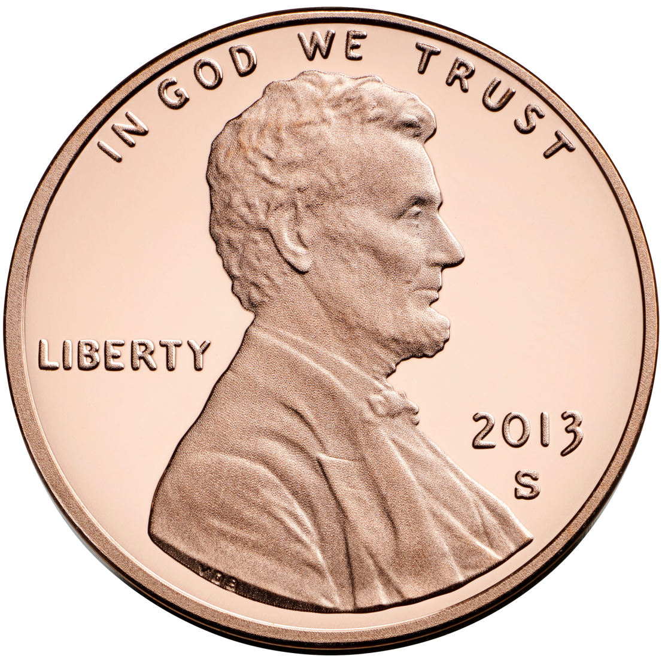
Penny For Your Thoughts
In the year…
Building Community

Slide 9
Purposeful Planning
Anticipating: What are the likely responses to challenging concepts?
Monitoring: What are the students’ actual responses to the tasks?
Selecting: Choosing particular students to present their work during the whole-class discussion
Sequencing: In what order will you present student responses?
Connecting: How can you bridge individual responses to key concepts in order to reinforce your objective?

Slide 10
Engaging Students

Slide 11
Engagement & Discussions
What is the connection?

Slide 12
Brain Over-Load?
Today’s Meet (Back-Channel Engagement)
Idea Wave
Synonym Rolls (Creative Groupings)
6 Thinking Hats
1 Sentence Summary
Engagement Strategies (Music, Art, Fun!)
Connecting Ideas → Learning Target
Closure (Final Slide)

Slide 13
Take-Aways
What 2 ideas can you take from today and use?

