Slide 1
Perseverance
Press F5
To Begin
M. Wagner

Slide 2
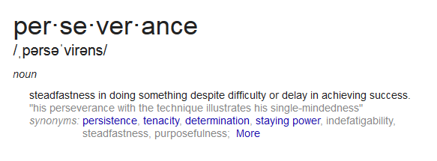
Perseverance
4 Syllables
1
2
3
4
www.dictionary.com

Slide 3
Perseverance
Pronunciation
www.dictionary.com

Slide 4
Perseverance
Part of Speech
www.dictionary.com

Slide 5
Perseverance
Actual Definition
www.dictionary.com

Slide 6
Perseverance
Synonyms are also available in a thesaurus!
Synonyms
(Word Choice)
www.dictionary.com

Slide 7
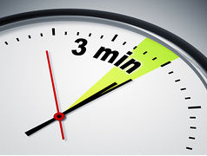
Quick Draw
Perseverance
Quickly Sketch a picture that shows what this word means to you.

Slide 8
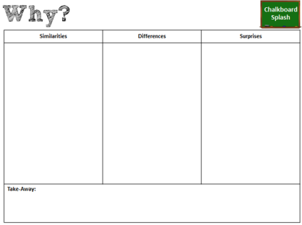
Gallery Walk
5
Post your sketches around the room.
Analyze the similarities & differences between your sketch and your classmates’ sketches.

Slide 9
Debrief
What were the similarities?

Slide 10
Debrief
What were the differences?

Slide 11
Debrief
What did you see that surprised you?

Slide 12
Take-Away
How would you describe the word “perseverance” after today’s activity?

