Slide 1
That’s Punny!

Slide 3
I wondered why the baseball was getting bigger…
Then it hit me!

Slide 4
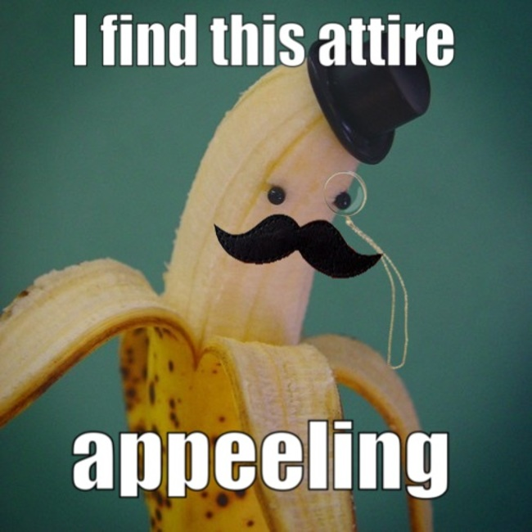

Slide 5
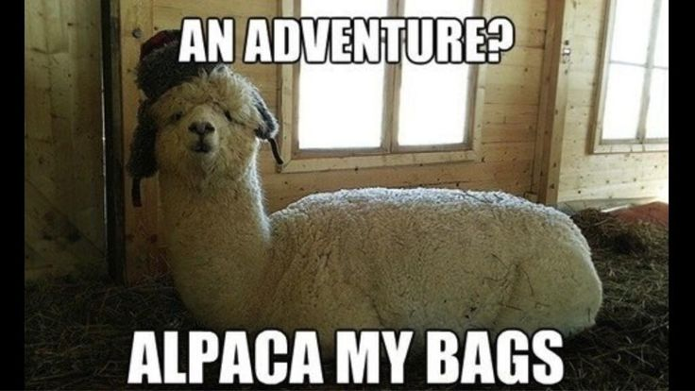

Slide 6
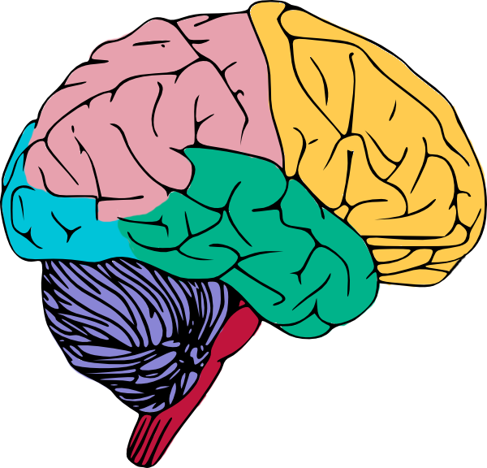
I was originally going to get a brain transplant;
but then I changed my mind!
By: Colin Thomas

Slide 7
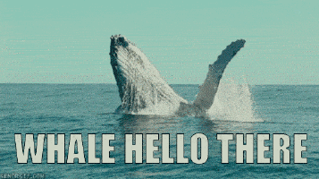

Slide 9
I’m reading a book about anti-gravity.
It’s impossible to put down!
By: Tori
Pun of the Day

Slide 12
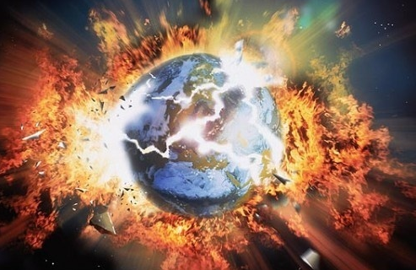
So what if I don’t know what “apocalypse” means!
It’s not the end of the world!
By: DrySpoon
Pun of the Day

Slide 13
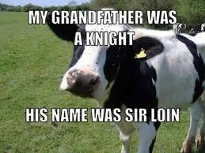

Slide 14
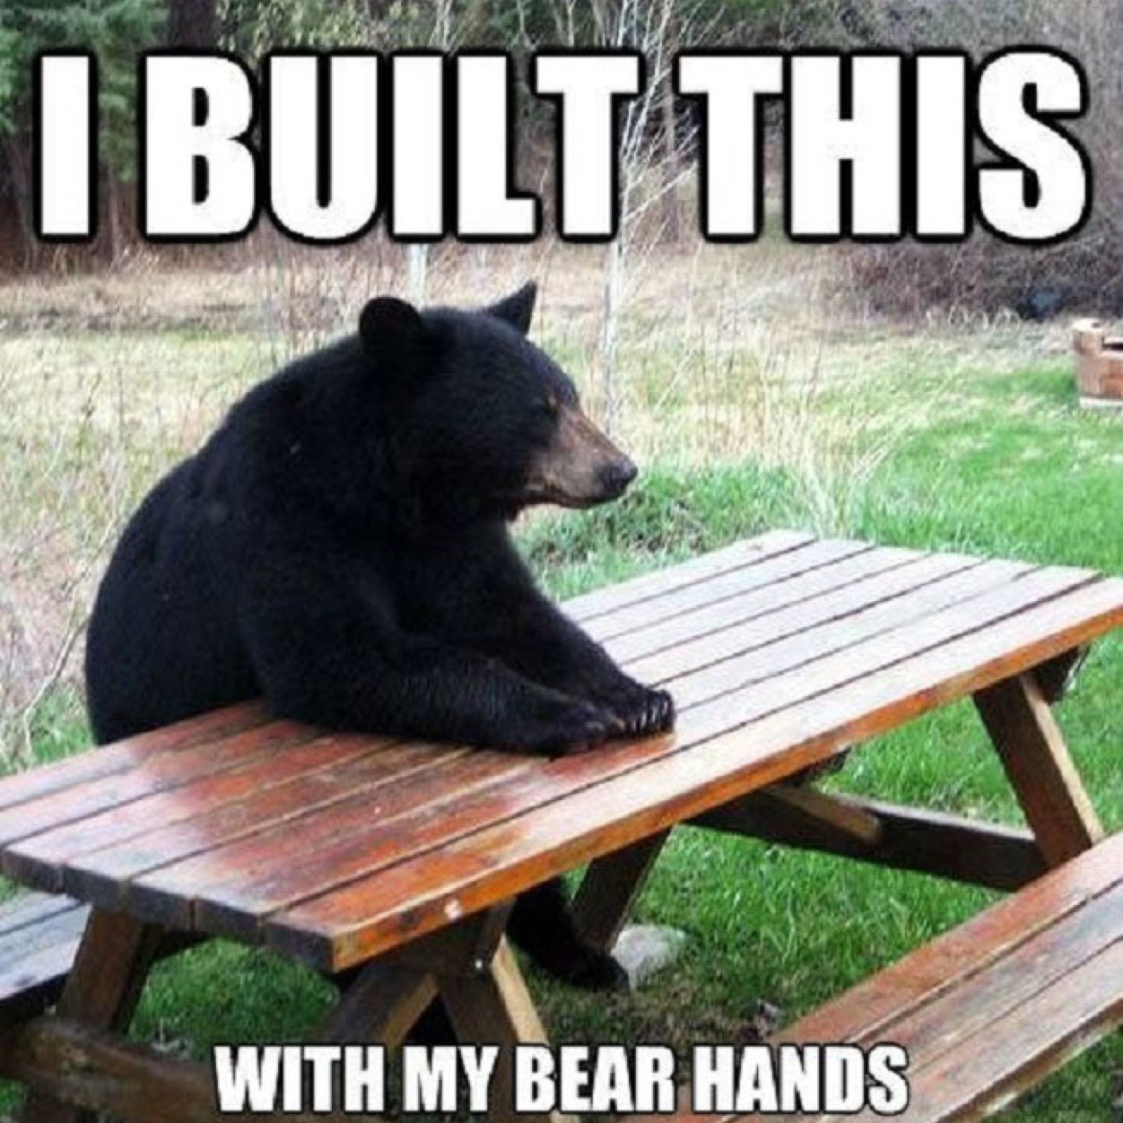

Slide 15
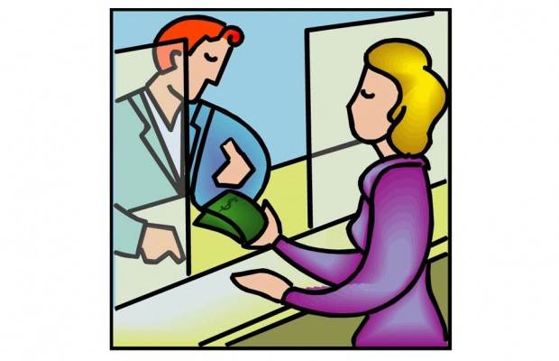
I used to be a banker;
but I lost interest!

Slide 16
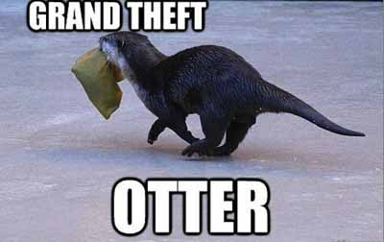

Slide 17
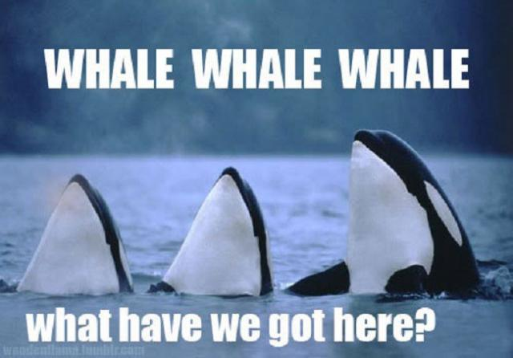

Slide 18
Never trust atoms!
They make up everything!

Slide 19
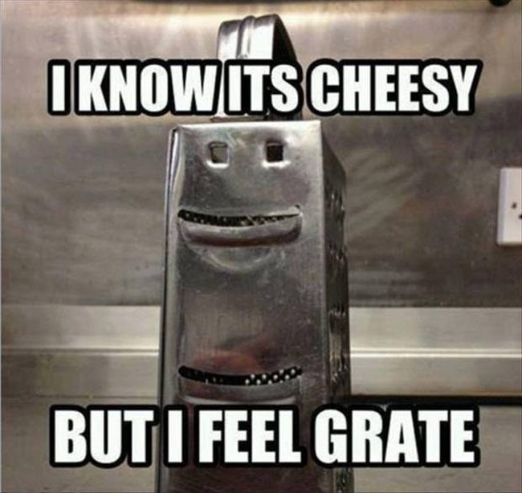

Slide 20
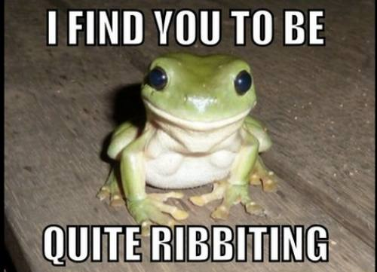

Slide 21
I can’t believe I got fired from the calendar factory!
All I did was take a day off!

Slide 22
To the guy who invented “Zero”:
Thanks for nothing!

Slide 24
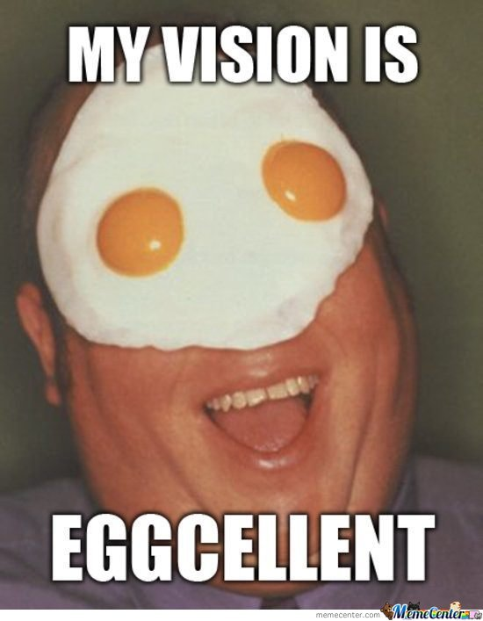

Slide 25
I had a few jokes about unemployed people…
But none of them worked!

Slide 26
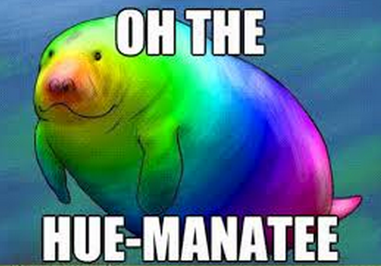

Slide 27
