Slide 1

How Raven Stole Crow’s Potlatch
A Native American Story
Loosely based on a Northwest Pacific Indian Myth
There are many tales of Raven the Trickster in Native American myths and legends. This is one of them.
Retold by Lin Donn
Illustrated by Phillip Martin

Slide 2
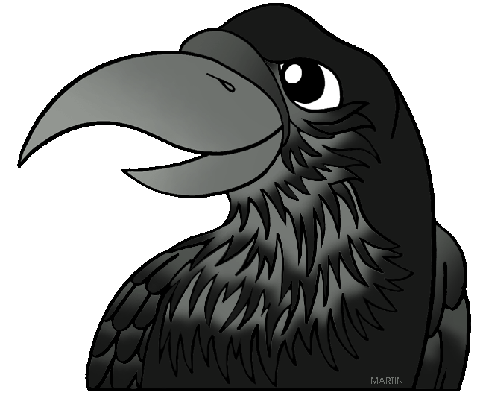
Raven
Once upon a time, a long time ago, there lived a magical bird named Raven. Raven was a shape shifter. He could
turn himself into a man and then back again into a bird simply by pulling his beak over his head, like a mask.
Over time, Raven learned how to turn himself into any animal. Raven could fool other animals into thinking he was, well, just about anybody.

Slide 3
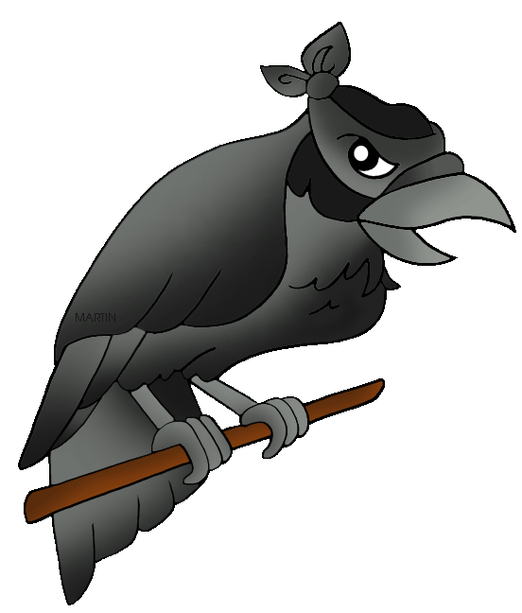
Raven
Raven was very smart. He had considerable charm. He was also a thief and a liar. Raven used his charm to make his lies sound like truth.
Creatures who trusted Raven often found themselves in big trouble. But Raven did not care. Raven was as selfish as he was clever.

Slide 4
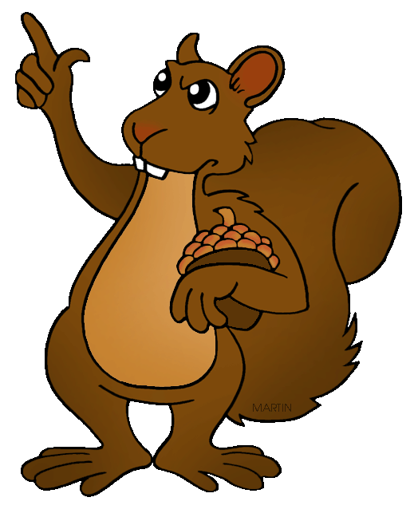
Raven
One day, Raven looked up at the sky. "Winter is coming," he said, in a surprised sort of way. "The snows will fall soon. I bet Squirrel has piled up lots of food by now.”
But when he flew by Squirrel's house, Squirrel hissed at him.
“Go away, Raven. You are not stealing food from me. Not one single nut."

Slide 5
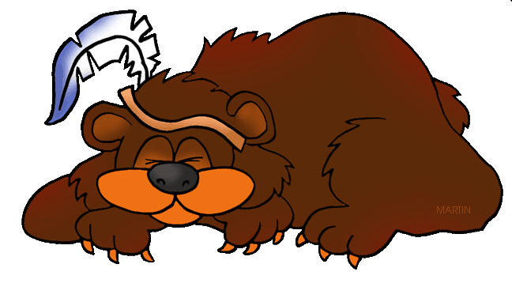
Raven
Raven spread his wings and soared away. "Bear will have food,” he thought. But when Raven arrived at Bear's cave, Bear was sound asleep for the winter. All Bear's food was stored in Bear's belly.
"Goose always knows where good food is hiding," Raven laughed. But when Raven arrived at Goose's home, no one was about. Goose had flown south for the winter.

Slide 6
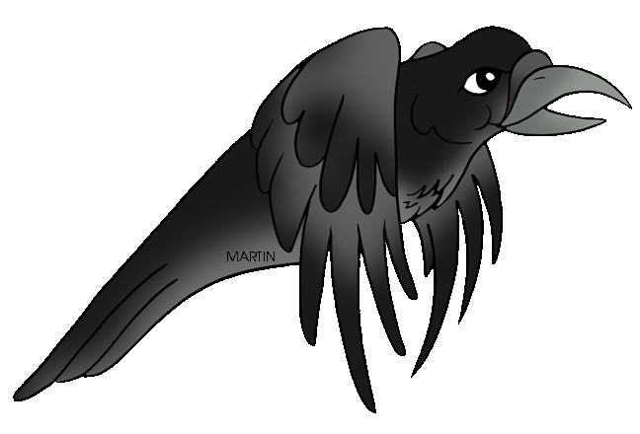
Raven
Raven soared off to the top of a tree to think things over. An idea took shape in his devious mind. Grinning broadly, Raven soared off in search of Crow. Crow was Raven's cousin.
"Crow!" Raven called out when he spotted him. "Everyone is talking about your beautiful voice! They can't wait to hear you sing!"

Slide 7
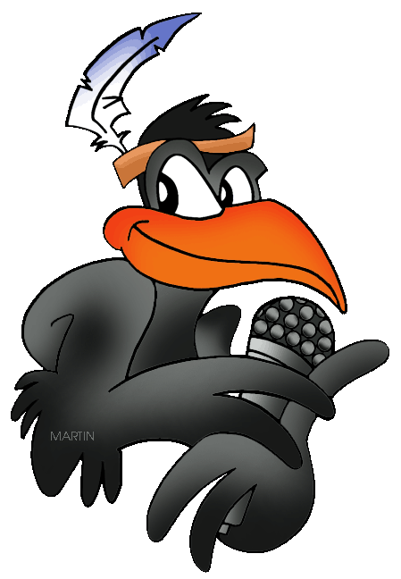
Raven
Crow knew that Raven was selfish. He knew Raven was a thief. He knew Raven often lied. Just the same, it was hard to resist Raven's charming compliments. Crow did have a beautiful voice. It was his one vanity, as Raven well knew.
"When is your potlatch? You're inviting me, right?" Raven begged eagerly.

Slide 8
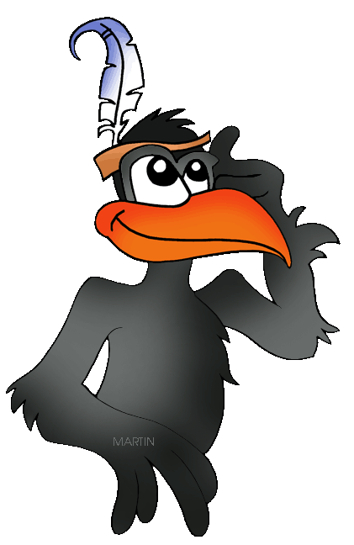
Raven
Crow shook his head. “A potlatch is a huge party. It would take all my winter storage of food to feed my guests. And what about all the cooking and cleaning?“
"I'll help you get ready!" Raven smiled warmly at his cousin. "I'm so proud to be related to you, Crow. Everyone wants to hear you sing!”

Slide 9
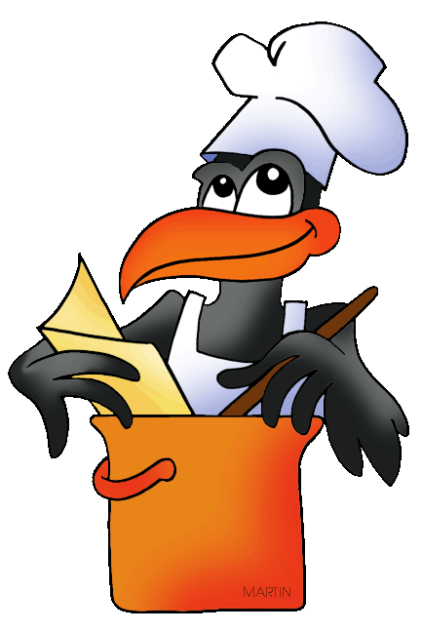
Raven
That very night Crow and Raven began cooking.
The next day, while Crow cooked and cleaned and practiced his singing, Raven flew all over the forest, inviting everyone to “his” potlatch.

Slide 10
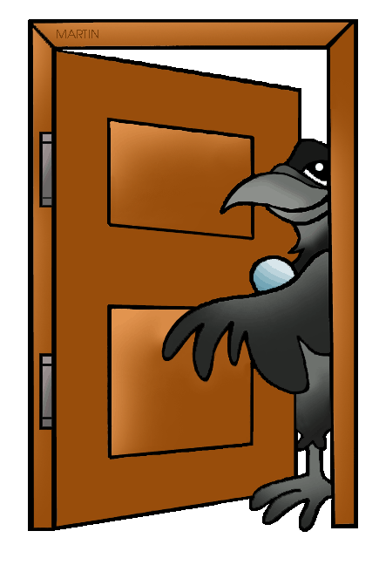
Raven
“I’m having a potlatch,” Raven told all the animals in the forest. “At Crow’s house. Come to the back door. That way, you won’t have to wait with the crowd to get in.”
Finally, the big day arrived. Everyone came to Raven's potlatch except the animals that had flown south for the winter, and the animals that were snoozing away in their caves and burrows. Everyone, that is, except Squirrel. Raven had not invited Squirrel.
Notes:
10

Slide 11
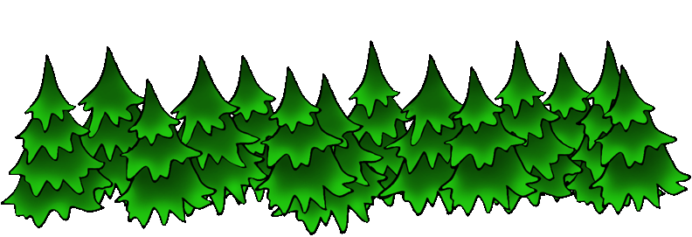
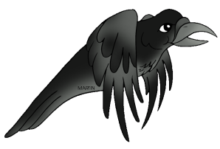
Raven
“There’s Elk," Raven called out. Raven soared off, supposedly to see who else was approaching. Instead, Raven quickly circled around and landed behind Crow's house. Raven used his magic powers to turn himself into Elk. He hurried to Crow’s front door.
"Welcome to my potlatch, Elk!" Crow welcomed Raven the Elk excitedly.

Slide 12
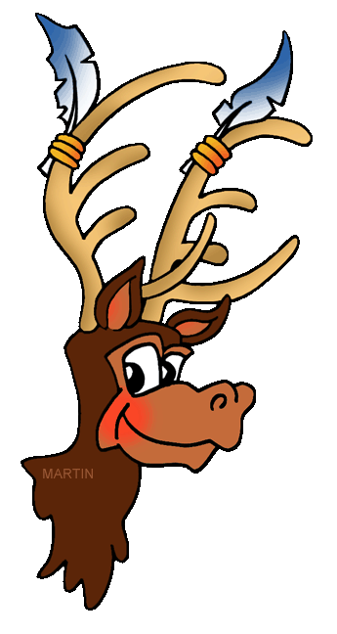
Raven
"Thank you for inviting me, Crow,” replied Raven, pretending to be Elk. “I can’t wait to hear your beautiful voice!” Raven the Elk lowered his head and entered Crow's house.
Raven flew out the back door, and changed himself into Rabbit. He hopped around to the front of Crow's house.

Slide 13
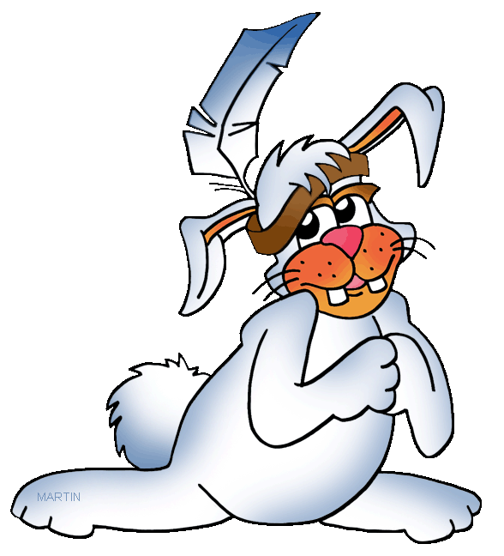
Raven
“Welcome Rabbit” cried Crow excitedly.
“Thank you for inviting me,” said Raven, who was pretending to be Rabbit. “I can’t wait to hear you sing!”
And so it went. Crow stood by his front door, welcoming what he thought were all the animals of the forest.
But really, each and every animal was only Raven in disguise.

Slide 14
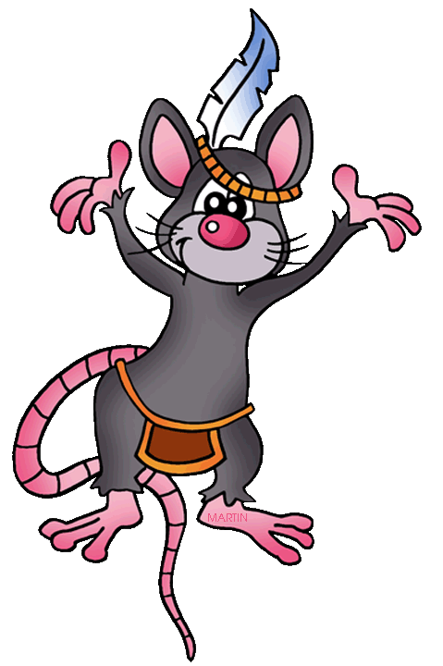
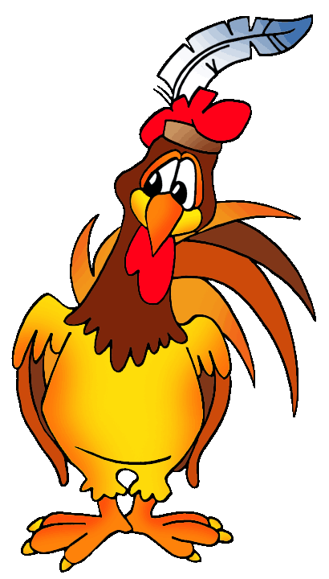
Raven
As for Raven, when he wasn’t busy tricking Crow, Raven stood at the back door, welcoming all the guests to “his” potlatch.
Raven was a bit winded from all his running about, but he found the whole thing delightful.
No one suspected a thing!

Slide 15
Raven
When all the real guests had entered through Crow's back door, Raven dragged Crow away from the front door, and pushed him into the middle of the room.
"Crow is going to sing for us," Raven shouted over the noise of the party. Crow's singing received huge cheers. "One more song, Crow," called Raven, over and over.
Bursting with happiness, Crow sang and sang until his voice was hoarse.

Slide 16
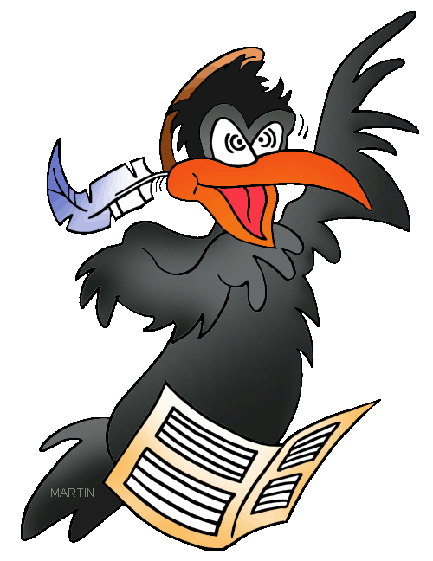
Raven
It was a wonderful party. At the end of the potlatch, each guest received a package of food to take home.
"Thank you for inviting me to your potlatch," each guest thanked Raven.
Crow tilted his head in puzzlement. He tried to tell his guests that this was HIS potlatch. But Crow's voice was gone.

Slide 17
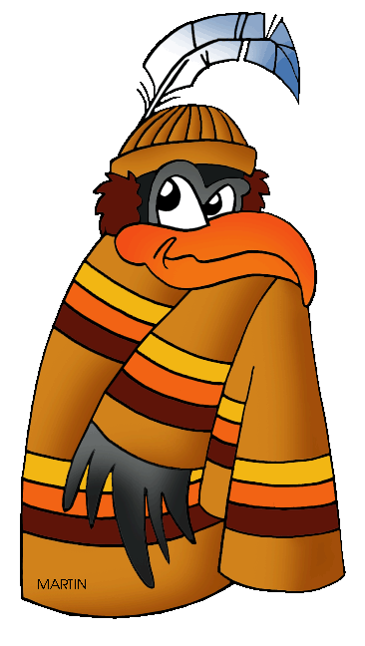
Raven
That winter, as he knew he would, Raven received invitations to many potlatches. Raven had a wonderful time, laughing and eating. At each potlatch, he received a package of food to take home.
But no one invited Crow. After all, Crow had never invited them to a party. Why should they invite him?

Slide 18
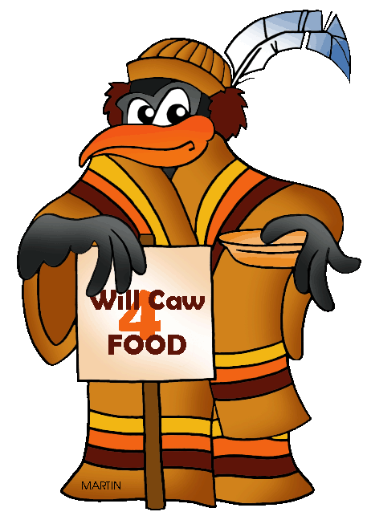
Raven
Poor Crow. To eat that winter, he had to beg scraps of food from the People.
Crow could not even tell anyone what Raven had done. Crow had lost his beautiful voice forever. The only sound he could make was a shrill "caw caw".
And that, I'm afraid, did not help him at all.

Slide 19
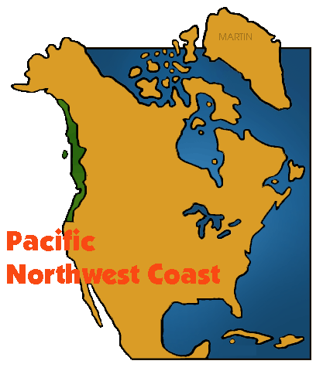
Learn More
To learn more about the Pacific NW Indians, go here: NW Pacific Coastal Indians
To learn more about Native Americans, go here:
Native Americans
For free clipart, go here:
Free Native American Clipart

Slide 20
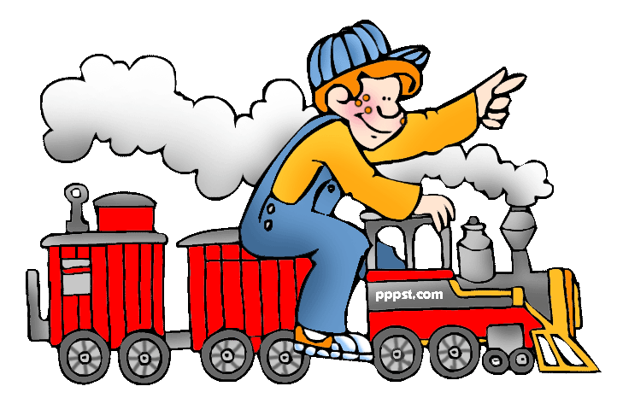
…
This presentation is brought to you by
Pete’s Power Point Station.
Visit us on the web at pppst.com

