Slide 1
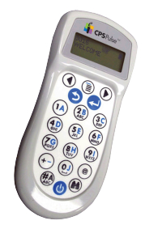
Let’s Reflect On Our Writing!

Slide 2
Ideas
I scored 40/40.
I scored between 35/40 & 39/40.
I scored between 30/40 & 34/40.
I scored between 25/40 & 29/40.
I scored between 20/40 & 24/40.
I scored 19/40 or less.

Slide 3
Organization
I scored 10/10.
I scored 9/10.
I scored 8/10.
I scored 7/10.
I scored 6/10
I scored 5/10

Slide 4
Voice
I scored 10/10.
I scored 9/10.
I scored 8/10.
I scored 7/10.
I scored 6/10
I scored 5/10

Slide 5
Word Choice
I scored 10/10.
I scored 9/10.
I scored 8/10.
I scored 7/10.
I scored 6/10
I scored 5/10

Slide 6
Sentence Fluency
I scored 10/10.
I scored 9/10.
I scored 8/10.
I scored 7/10.
I scored 6/10
I scored 5/10

Slide 7
Conventions
I scored 10/10.
I scored 9/10.
I scored 8/10.
I scored 7/10.
I scored 6/10
I scored 5/10

Slide 8
Presentation
I scored 10/10.
I scored 9/10.
I scored 8/10.
I scored 7/10.
I scored 6/10
I scored 5/10

