Slide 1
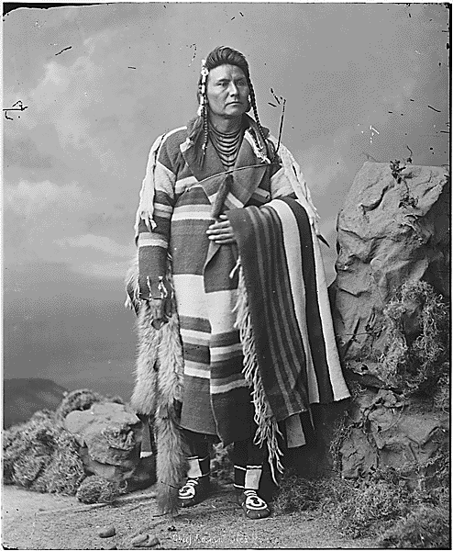
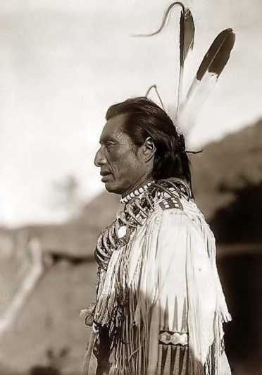
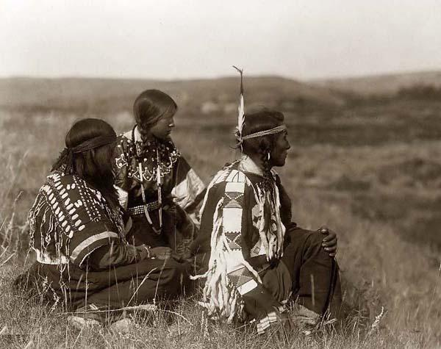
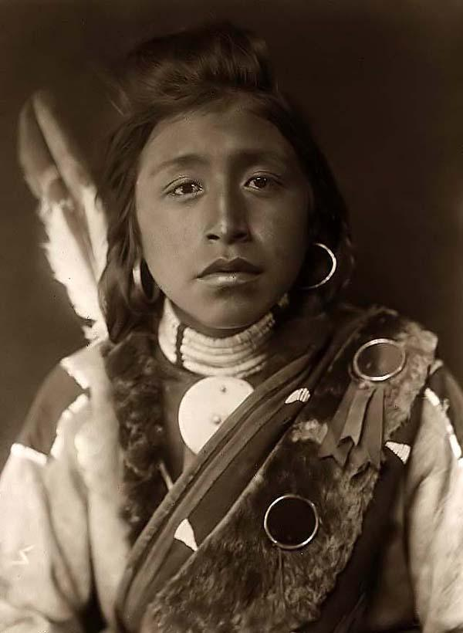
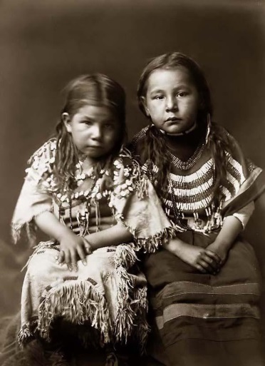
Chief Joseph and the Nez Perce of the Great Plains
Power point created by Robert L. Martinez
Primary Content Source: A History of US; Reconstructing America by Joy Hakim

Slide 2
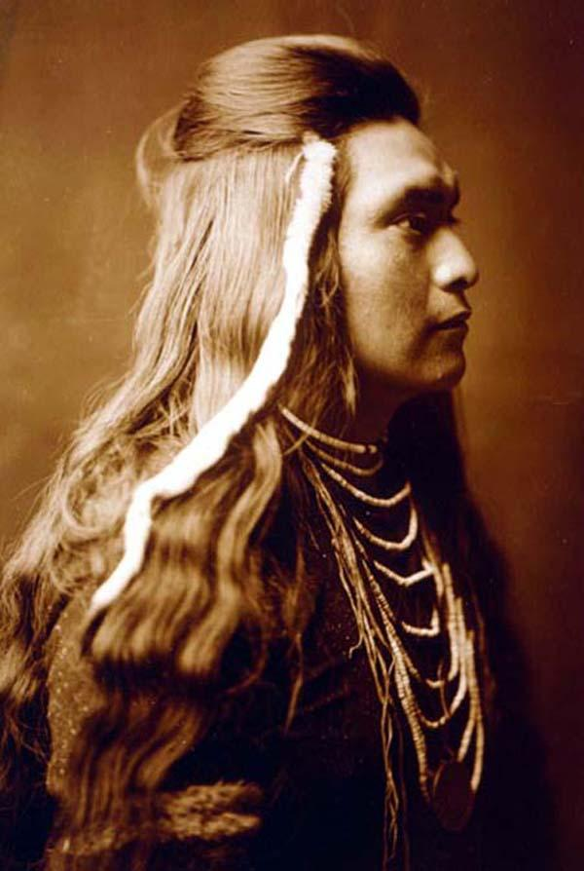
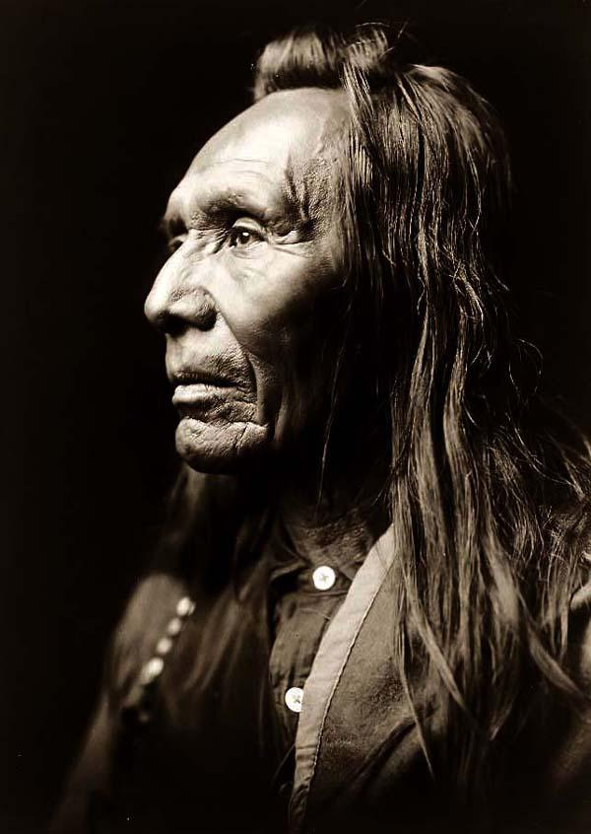
The Nez Perce (Sioux) Indians were special. They were honest, honorable, courageous, intelligent, and independent.

Slide 3
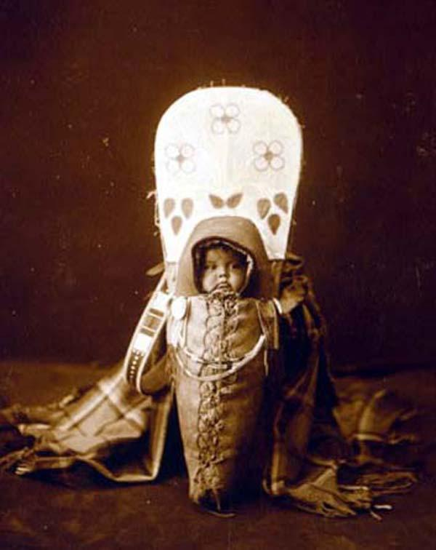

Slide 4
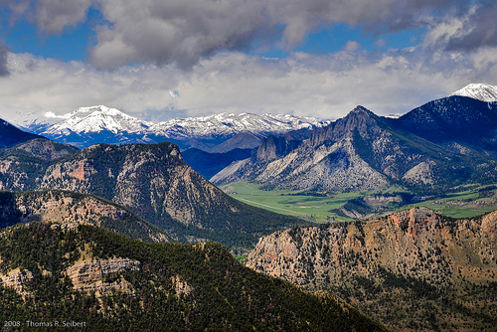
The Sioux lived in a region that was a kind of paradise. Their land, where today, Idaho, Washington, and Oregon come together, holds rich valleys, grassy prairies, steep mountains, and canyons.

Slide 5
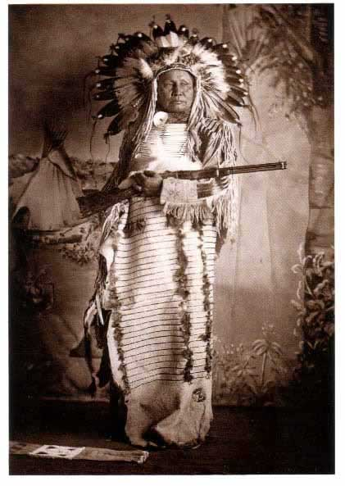

Slide 6
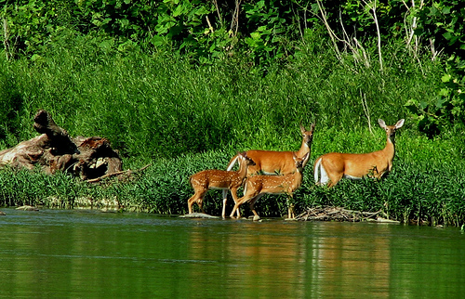
The Nez Perce Sioux shared that land with numerous wildlife and fish.

Slide 7
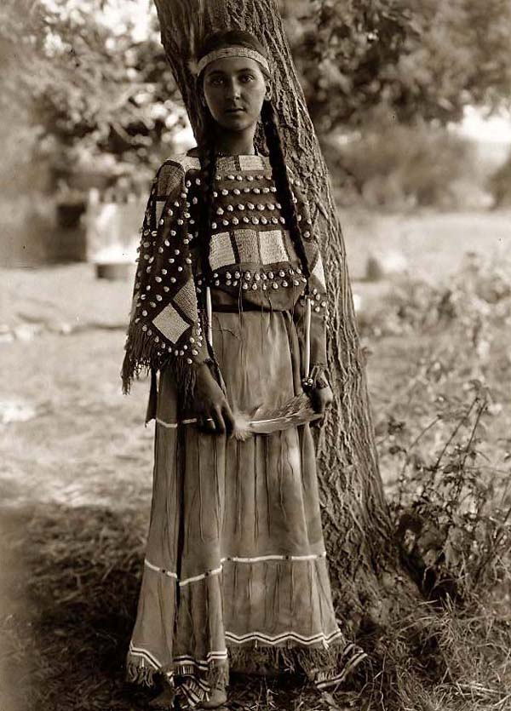

Slide 8
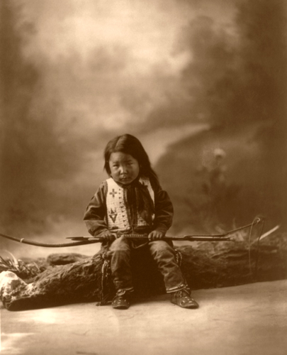
The Nez Perce were mighty hunters, and known for their strong bows. Other tribes traded their most precious valuables for those bows.

Slide 9
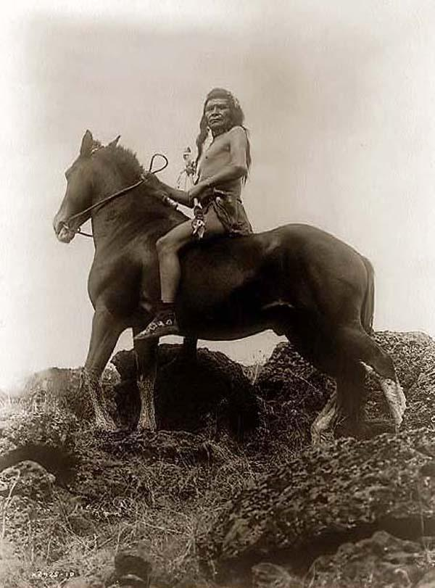
When horses arrived in this northern region, the Sioux quickly became skilled riders.

Slide 10
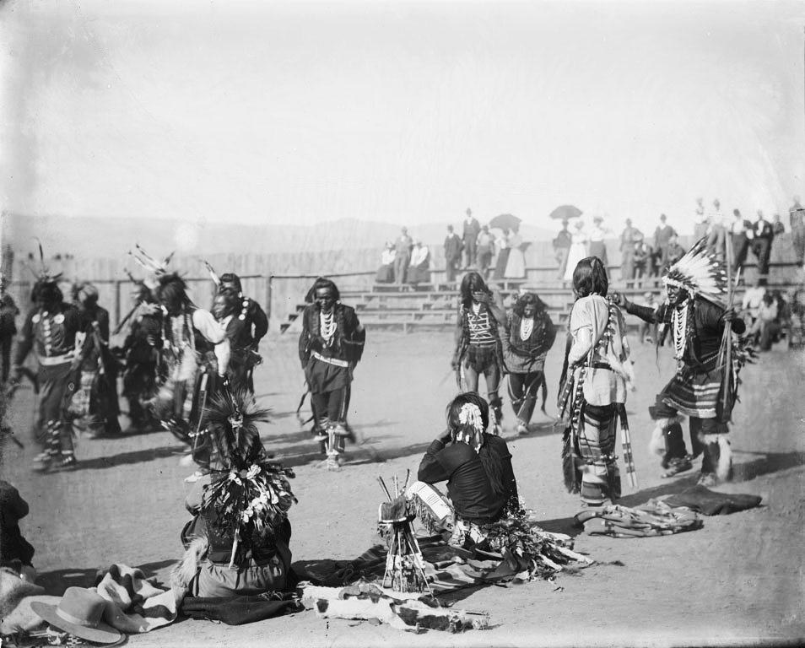
The Sioux lived in a kind of democracy where individuals were respected.

Slide 11
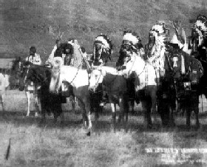
The Nez Perce had enemies, and, although they loved peace, they fought frequently and captured slaves.

Slide 12
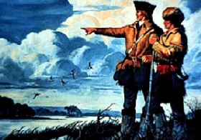
The Sioux must have been surprised when Meriwether Lewis and William Clark stumbled into one of their camps. It was late September, in 1805.

Slide 13
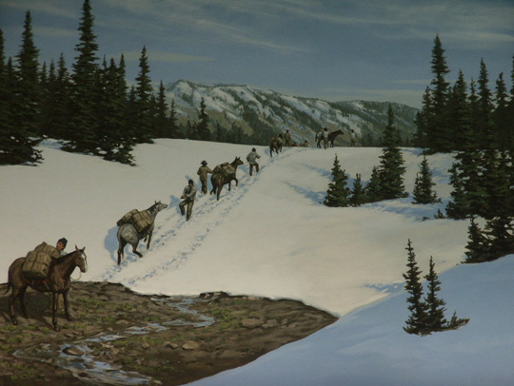
The Lewis and Clark expedition was sent to explore the West by President Jefferson. They had been caught in a mountain snowstorm. The group was starving.

Slide 14
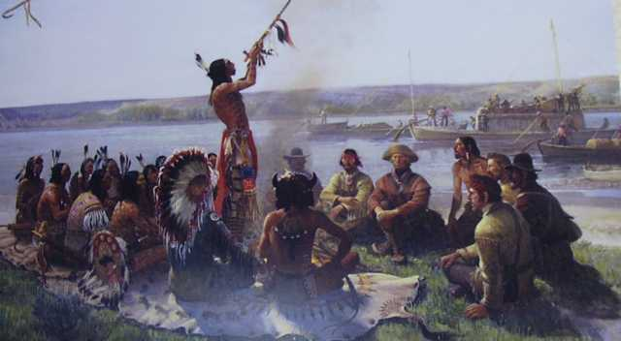
The Sioux fed Clark and his men buffalo steak and camas roots and probably saved their lives.

Slide 15
Lewis and Clark convinced the Native Americans to stop the warring between tribes; that would make it safe for white men to open trading posts to sell goods and firearms.

Slide 16
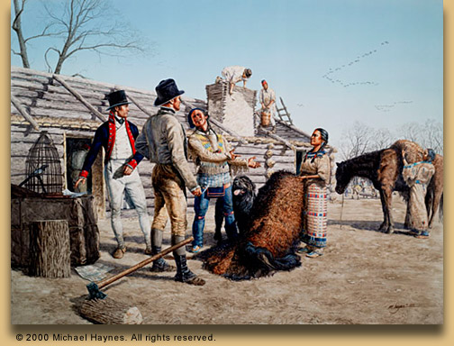
The Indians wanted those goods, and they held a council and promised “to cultivate peace” between the tribes.

Slide 17
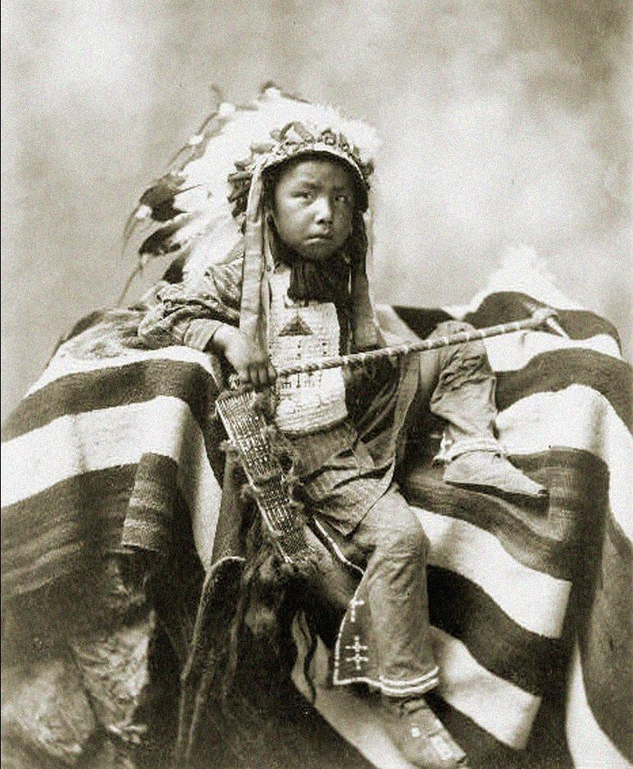

Slide 18
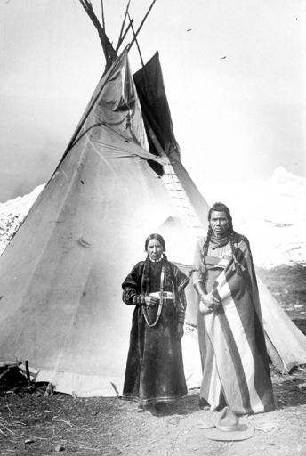

Slide 19
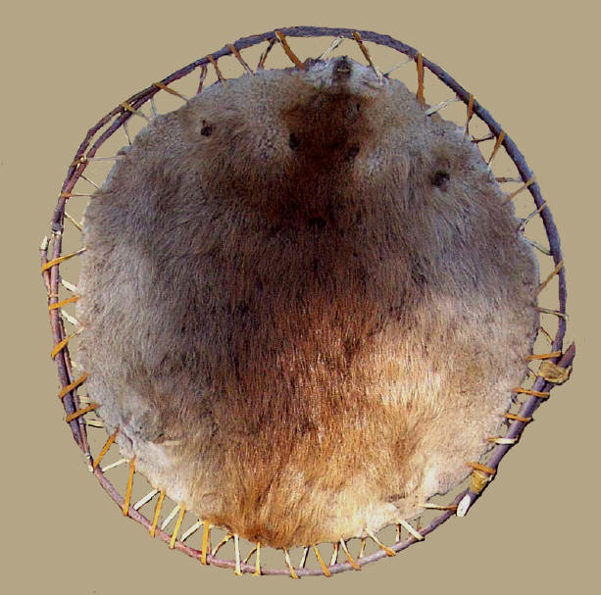
It was the beginning of peaceful times. The Sioux helped the white trappers, and befriended those white settlers who were beginning to pass through their land.

Slide 20
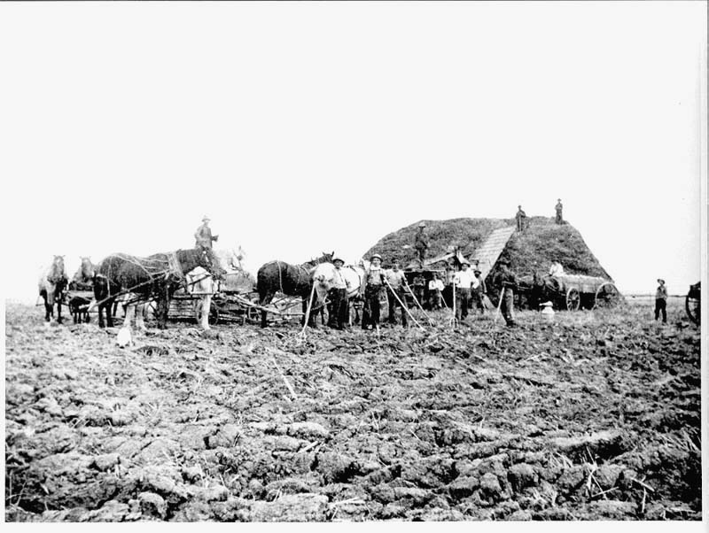
Everything changed when gold was discovered on their land in 1860. The miners trespassed on their lands. Many settlers began to homestead on their lands.

Slide 21
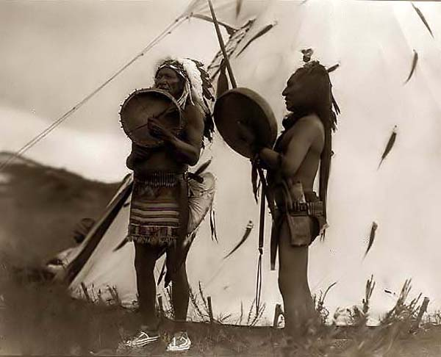
Some Nez Perce signed treaties to give up some of their land, but others wouldn’t do it. They wouldn’t sign the white man’s paper.

Slide 22
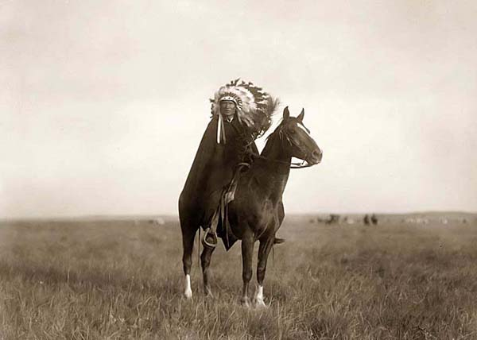

Slide 23
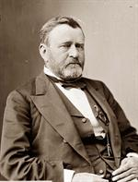
President Grant tried to solve the problem by setting aside a section of land “as a reservation for the roaming Nez Perce Indians.”

Slide 24
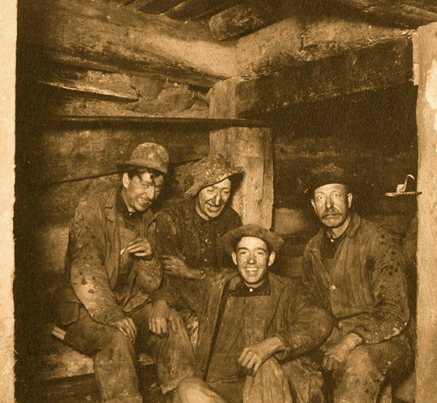
Settlers were not allowed on that (reservation) land, but that didn’t stop the miners and homesteaders.

Slide 25
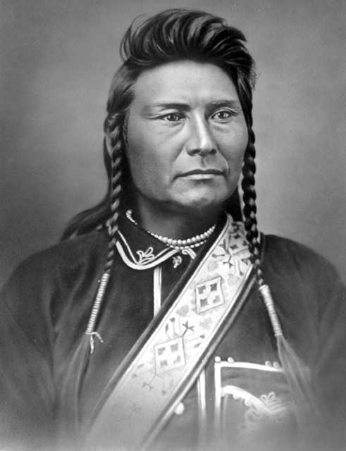
One of the “no-treaty” tribes was led by a man most Americans called Chief Joseph.

Slide 26
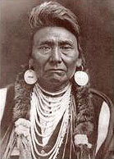
Chief Joseph asked his people to be patient, he didn’t want to fight the white settlers.

Slide 27
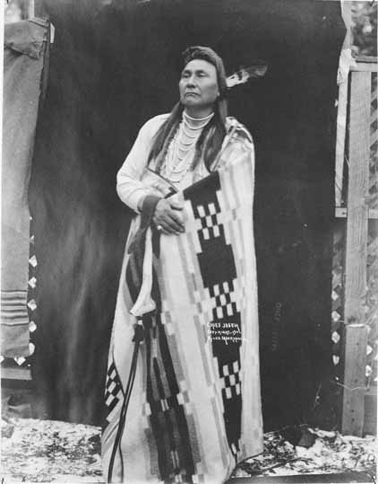
In 1876, the U.S. government sent commissioners to meet with Chief Joseph. They wanted him to move from his land to another reservation.

Slide 28
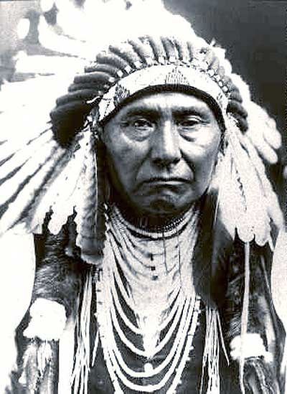
Chief Joseph would not agree to move. “We love the land,” he said, “It is our home.”

Slide 29
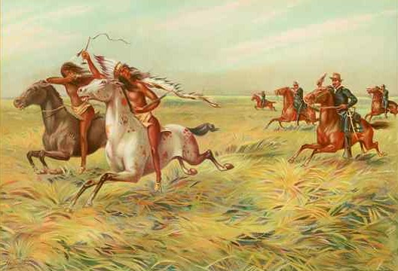
But the Sioux had no choice, the newcomers had great weapons and numbers. The Indians were forced onto a reservation.

Slide 30
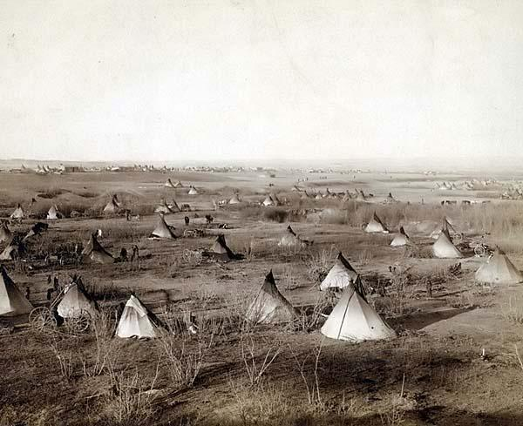
The commissioners had no patience. They wanted the Indians removed quickly by military force.

Slide 31
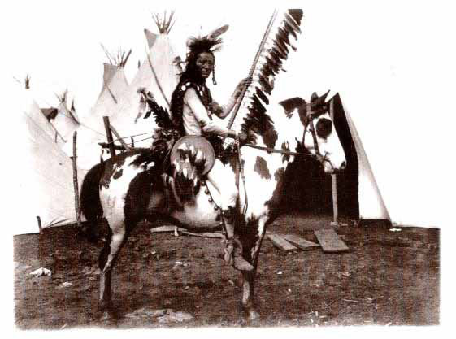
During the move, one young Indian, whose father had been murdered by white settlers, killed some of the white men. Now the whites had a reason to attack.

Slide 32
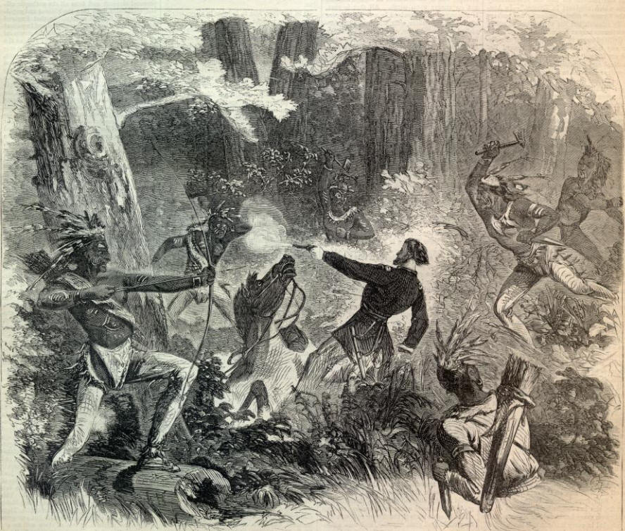
When they were attacked, the Nez Perce fought. The first battle began when Indians, carrying a white flag of truce, approached the soldiers…

Slide 33
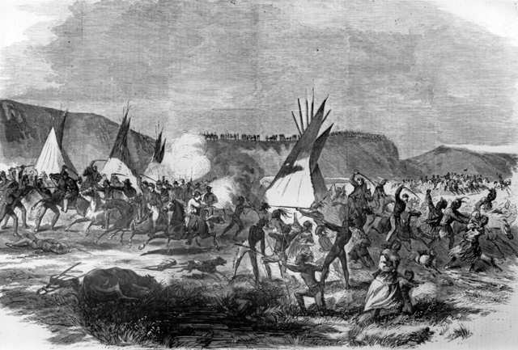
…a shot rang out and the Indians returned fire. The fight was brief, 34 U.S. soldiers died, and no Sioux.

Slide 34
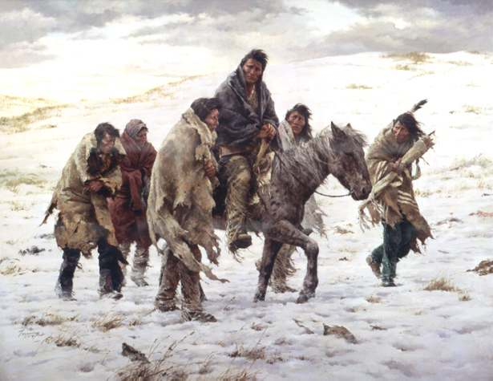
The Indians knew that other soldiers would soon be after them. The Sioux raced for safety in Canada (a thousand mile journey.)

Slide 35
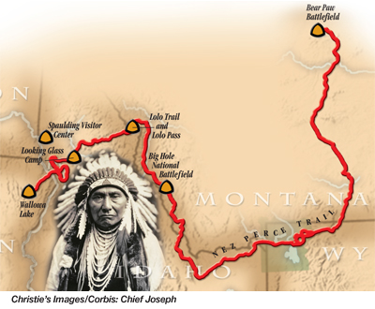

Slide 36
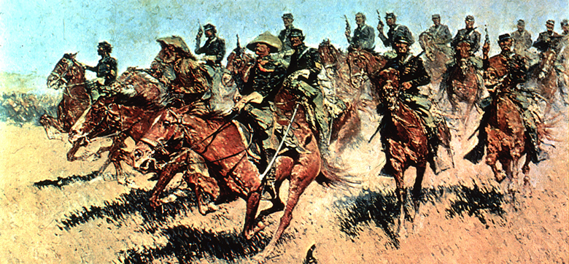
First one army, then another, and another, followed and fought the Sioux.

Slide 37
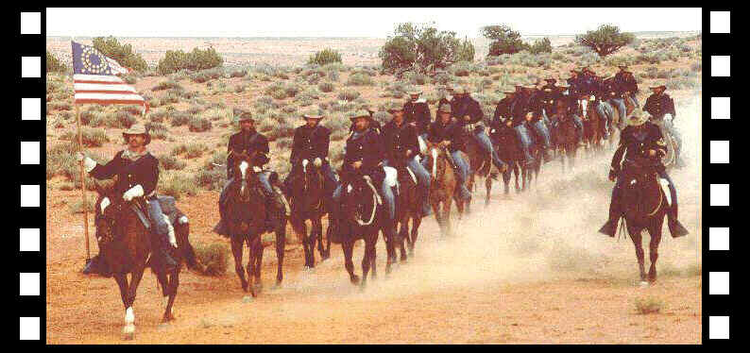
Finally, just 30 miles from Canada, facing new soldiers, the Nez Perce were surrounded.

Slide 38
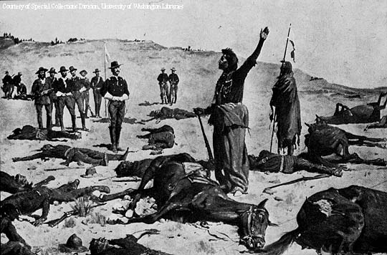
Chief Joseph
“I am tired of fighting. Our chiefs are killed…The old men are dead…The little children are freezing to death. My people… have run away to the hills, and have no blankets, no food…”

Slide 39
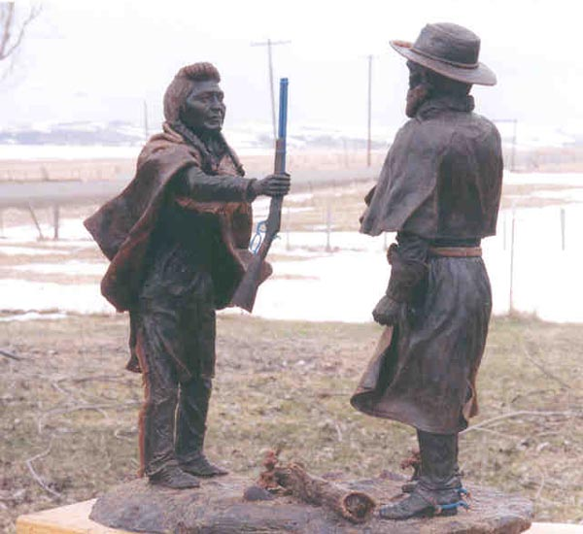
“My heart is sick and sad. From where the sun now stands I will fight no more forever.” – Chief Joseph

Slide 40
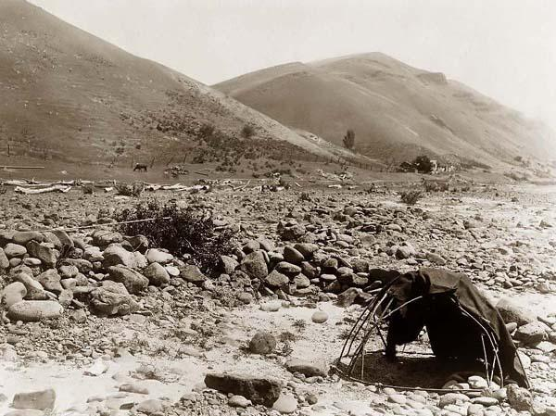
That day, promises were made to Chief Joseph, but they were never kept. The Nez Perce were sent to barren lands; most Sioux sickened and died.

Slide 41
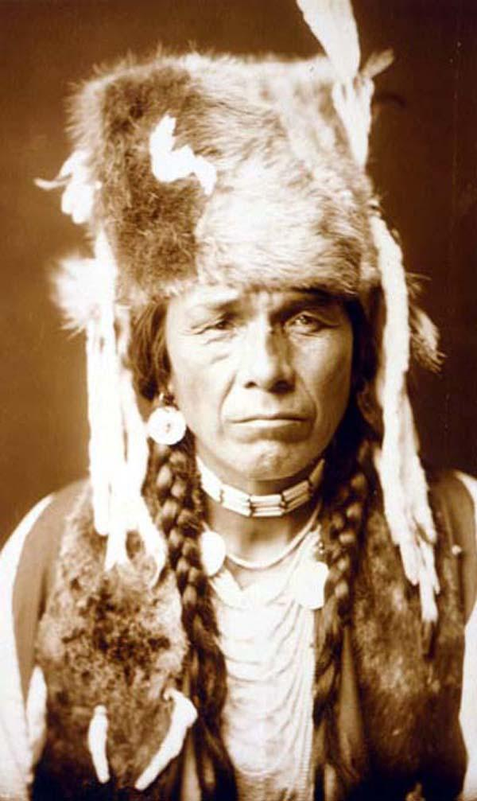
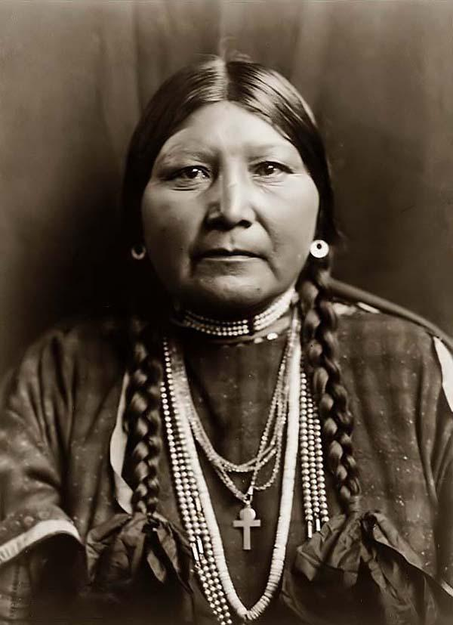
“All men were made by the same Great Spirit Chief. They are all brothers. The earth is the mother of all people, and all people should have equal rights upon it.”
- Chief Joseph

Slide 42
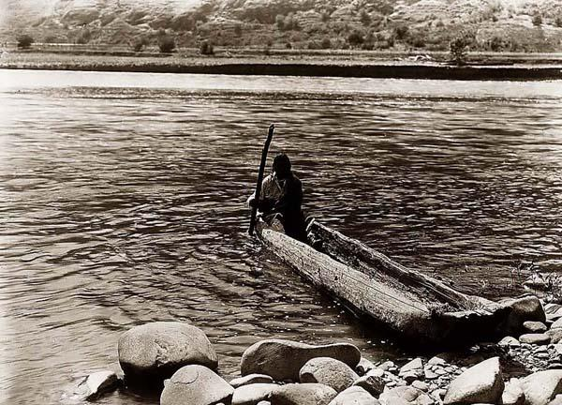
“You might as well expect the rivers to run backward as that any man who was born a free man should be contented when penned up and denied liberty to go where he pleases.” – Chief Joseph

Slide 43
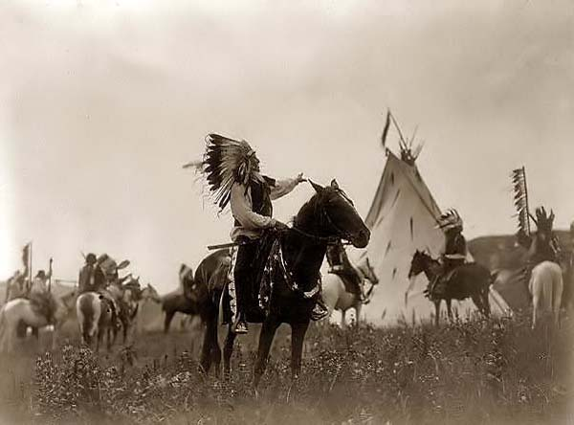
Chief Joseph
“We only ask an even chance to live as other men live. We ask to be recognized as men. We ask that the same law shall work alike on all men.”

Slide 44
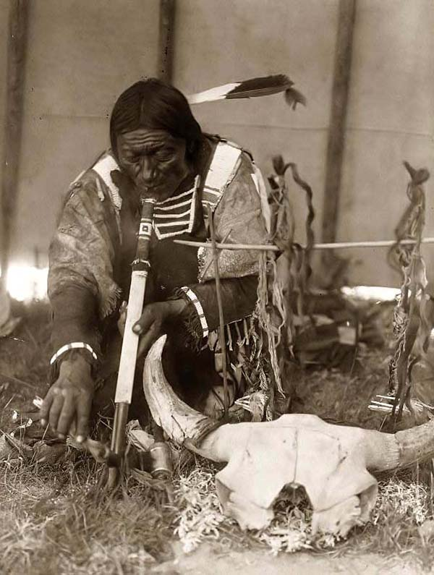
Chief Joseph
I choose…free to follow the religion of my fathers, free to think and talk and act for myself, and I will obey every law, or submit to the penalty.”

Slide 45
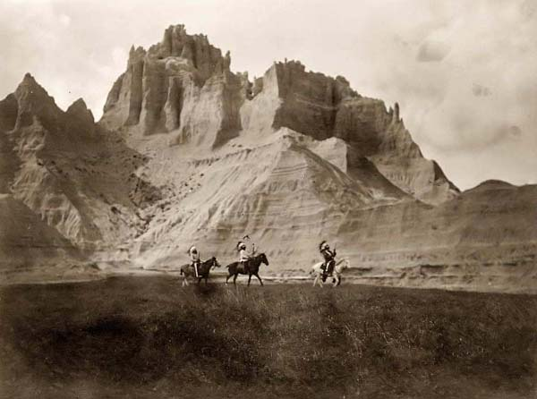
“Whenever the white man treats the Indians as they treat each other, then we will have no more wars. We shall all be alike…with one sky above us and one country around us.” – Chief Joseph

