Slide 1
Stories Artists Tell…
Procedure:
 Introduce the idea of “versions” of a story to the students.
Show students Millet’s original “First Steps” and let them analyze the drawing.
What story is being told?
Who are the characters?
What details do you see?
Show students Van Gogh’s “First Steps, After Millet” and let them analyze the painting.
Point out that while the original characters are still there, it still looks different from the original.
Brainstorm differences and similarities between the two pieces.
How is the story told in this painting different from the original story?
Show students Picasso’s “Mother and Child (First Steps)” and let them analyze the painting.
Point out that another artist expressed the same idea in a completely different way.
Connect versions of stories to versions of art.

Slide 2
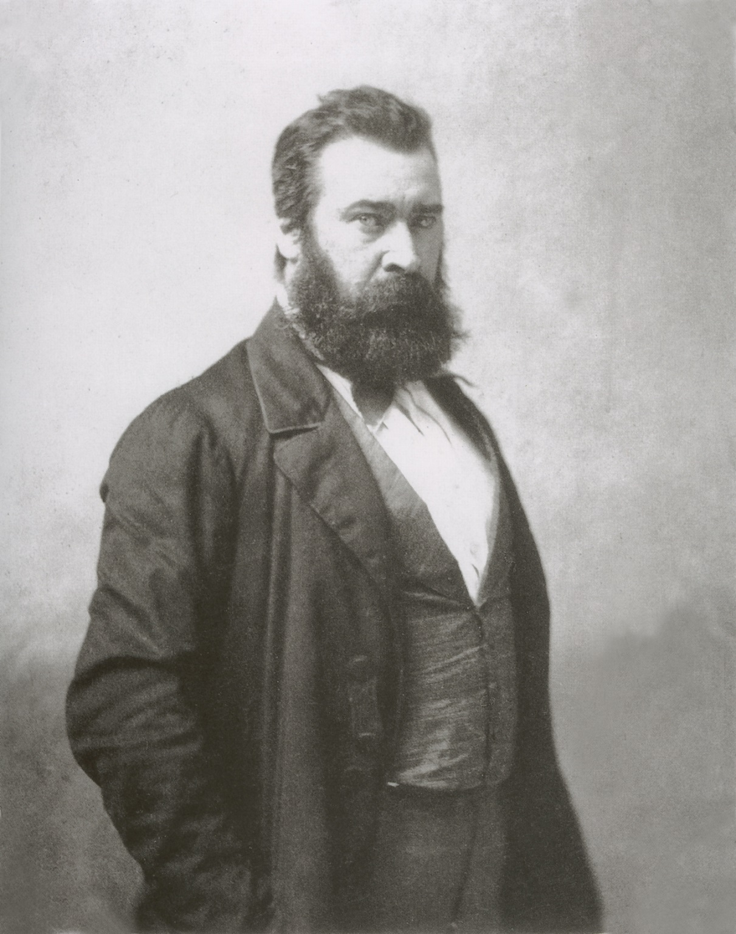
Jean-Francois
Millet
He called his pencil drawing
First Steps.

Slide 3
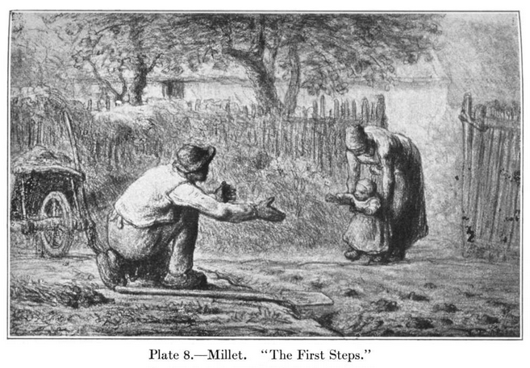
By: Millet

Slide 4
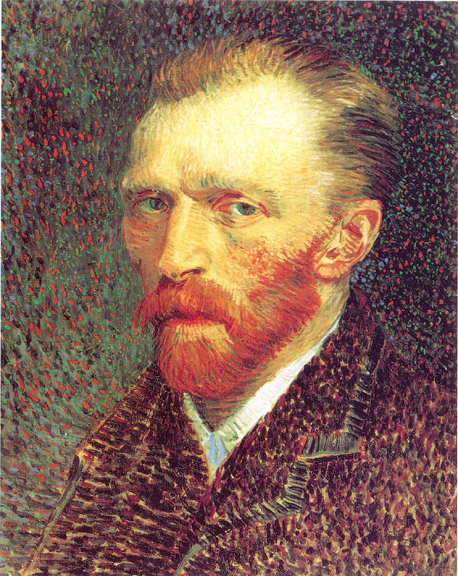
Vincent
Van Gogh
He painted a copy of Millet’s art and named it
First Steps,
After Millet.

Slide 5
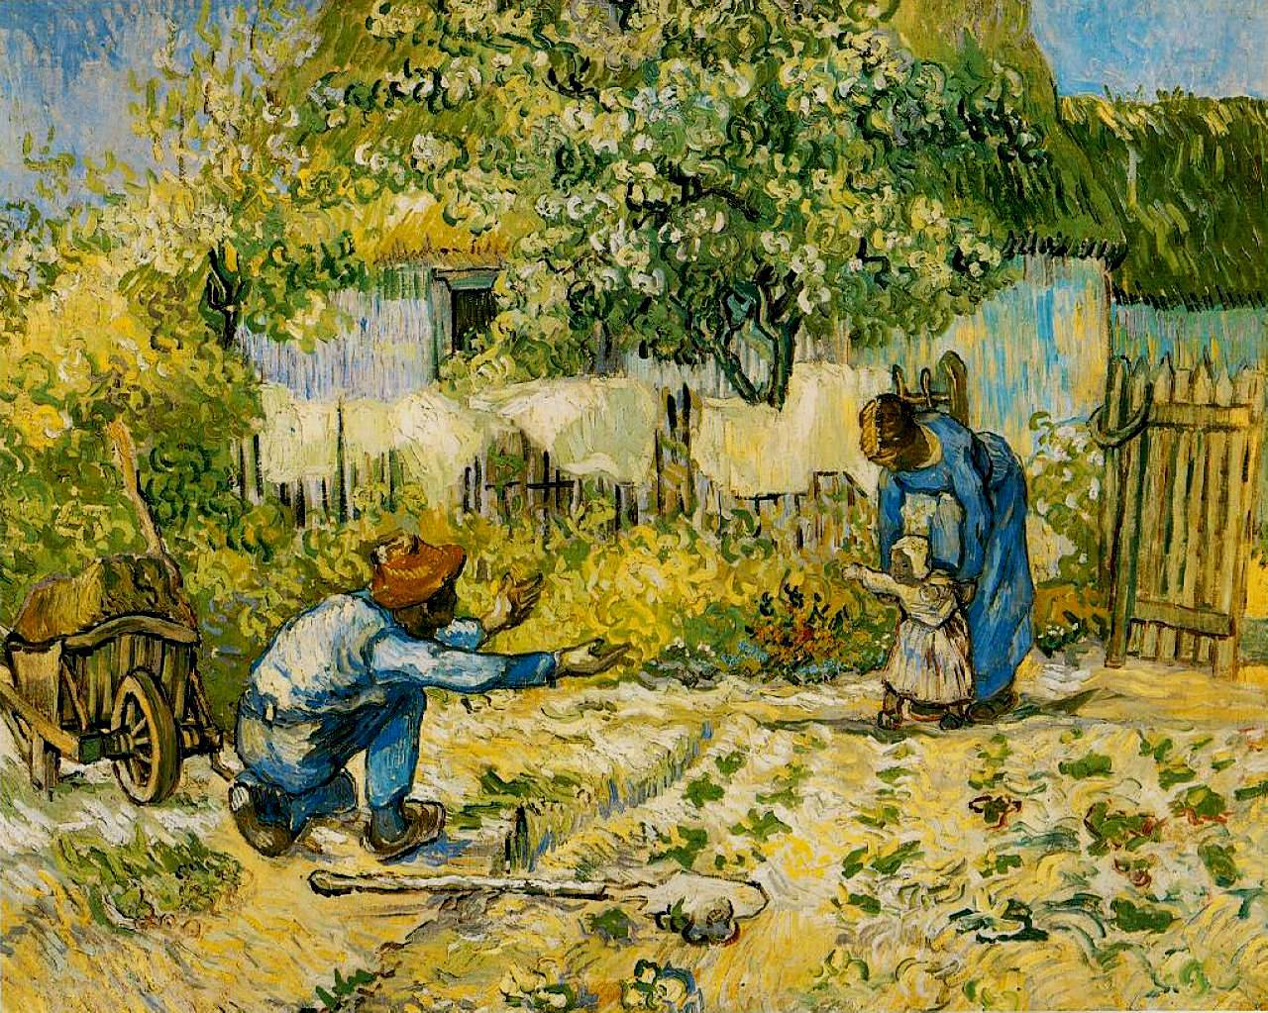

Slide 6
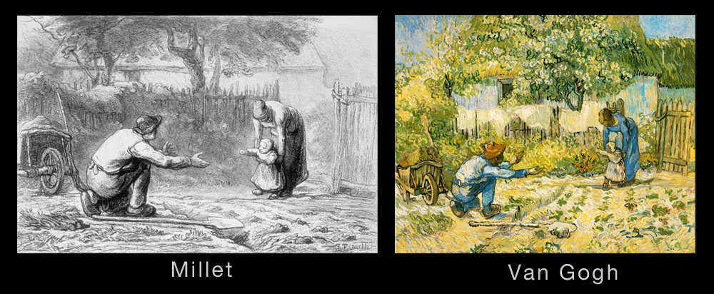

Slide 7
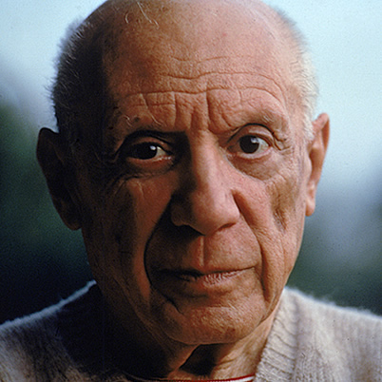
Pablo
Picasso
He called his painting
Mother and Child
(First Steps).

Slide 8
