Slide 1
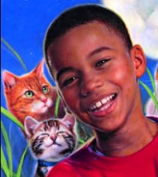
Julian’s Character Traits
How would you describe Julian?
Use examples from the text to support your response.
My opinions
Textual Evidence
I believe Julian is ______
because the text said…

