Slide 1
Heritage
Press F5
To Begin
Chalkboard Splash
M. Wagner

Slide 2
Heritage
3 Syllables
1
2
3
noun
1: the traditions, achievements, beliefs, etc., that are part of the history of a group or nation
www.dictionary.com

Slide 3
Heritage
Pronunciation
noun
1: the traditions, achievements, beliefs, etc., that are part of the history of a group or nation
www.dictionary.com

Slide 4
Heritage
Part of Speech
noun
1: the traditions, achievements, beliefs, etc., that are part of the history of a group or nation
www.dictionary.com

Slide 5
Heritage
Actual Definition
noun
1: the traditions, achievements, beliefs, etc., that are part of the history of a group or nation
www.dictionary.com

Slide 6
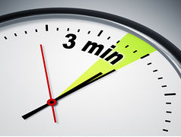
Heritage

Slide 7
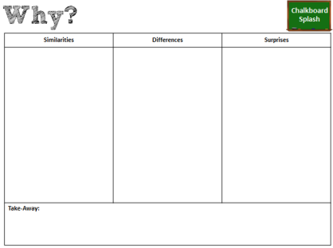
5
Post your sketches around the room.
Analyze the similarities & differences between your sketch and your classmates’ sketches.
Record Your Observations

Slide 8
What were the similarities?

Slide 9
What were the differences?

Slide 10
What did you see that surprised you?

Slide 11
How would you describe your heritage
after today’s activity?

