Slide 1
Native American Art

Slide 2
Art
There is no word in many Native languages for art, and no distinction made between what was decorative and what was functional, or what was sacred and what secular. Native art is closely linked to the natural world, and to spiritual connections of interrelatedness, a sense of deep harmony with the order of the universe.

Slide 3
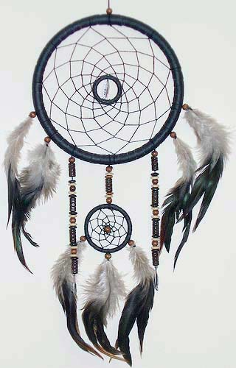
Dream Catchers
An ancient Chippewa tradition The dream net has been made For many generations Where spirit dreams have played.
Hung above the cradle board, Or in the lodge up high, The dream net catches bad dreams, While good dreams slip on by.
Bad dreams become entangled Among the sinew thread. Good dreams slip through the center hole, While you dream upon your bed.
This is an ancient legend, Since dreams will never cease, Hang this dream net above your bed, Dream on, and be at peace.
Unknown

Slide 4
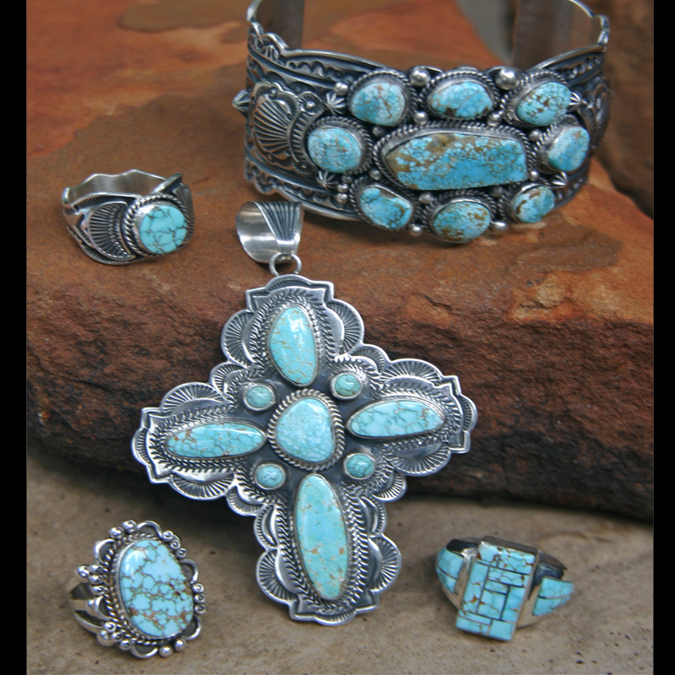
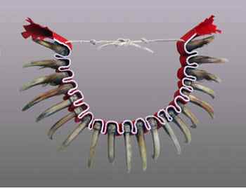
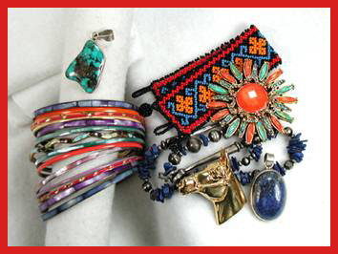
Jewelry
Notes:
Jewelry

Slide 5
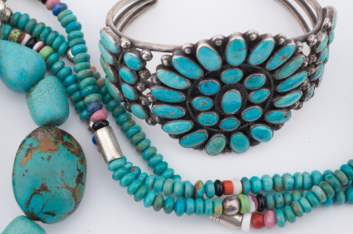
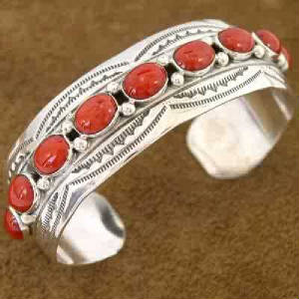
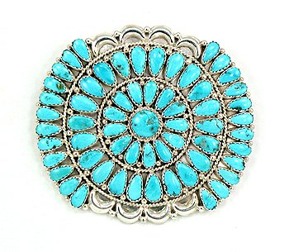
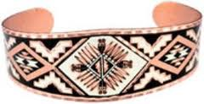

Slide 6
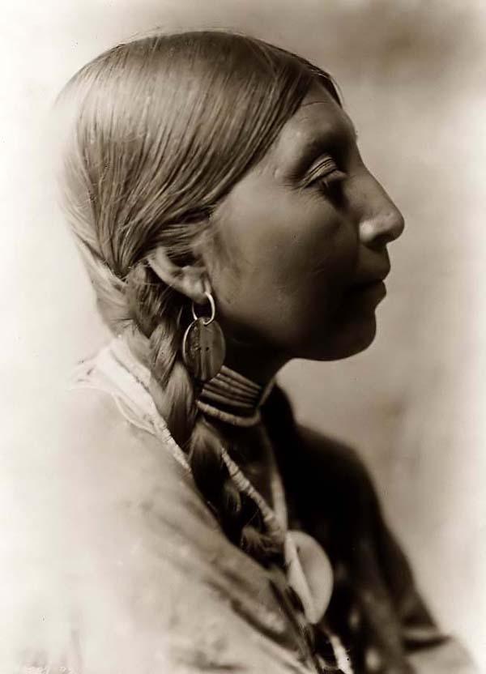

Slide 7
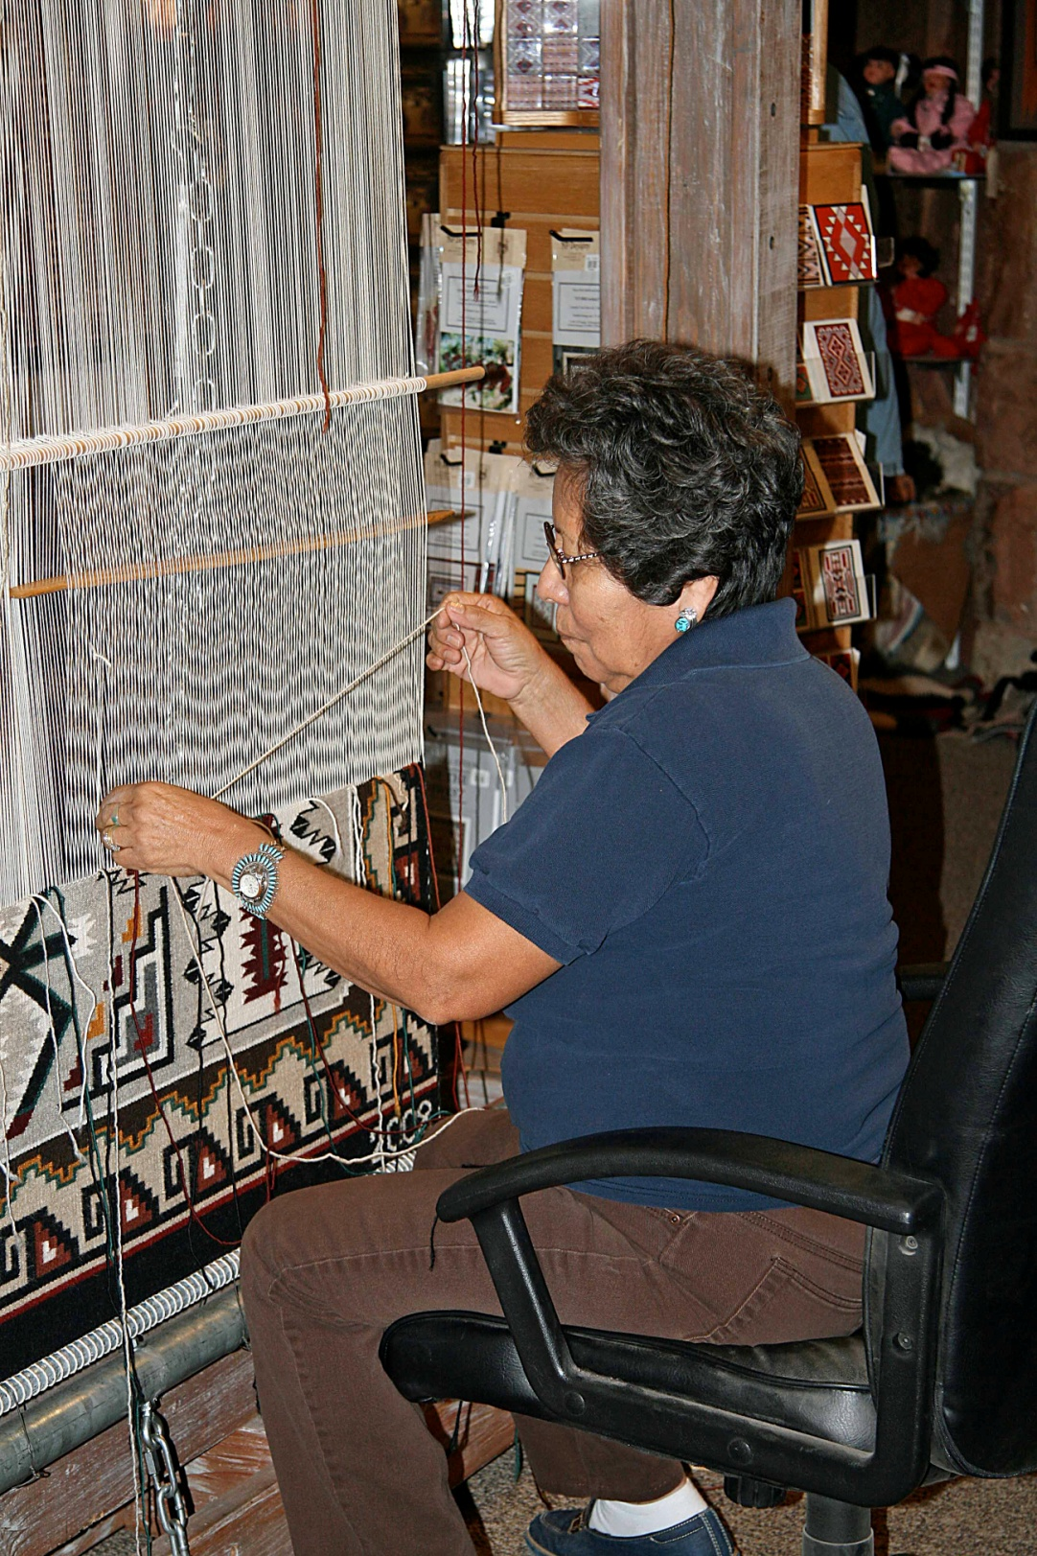
Weaving

Slide 8
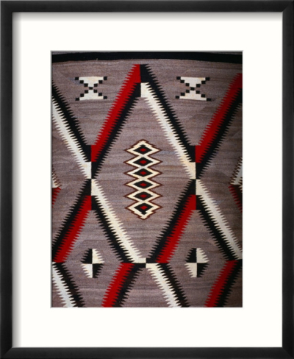
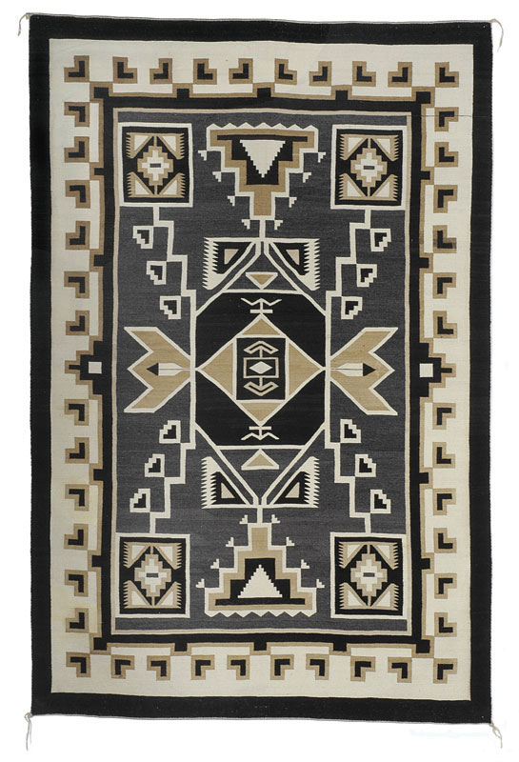
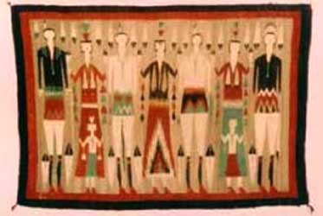

Slide 9
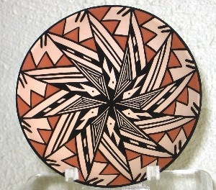
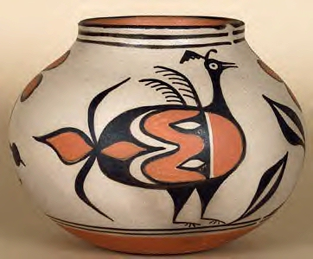
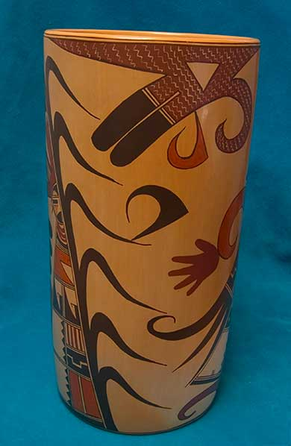
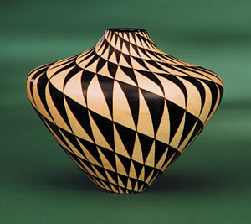
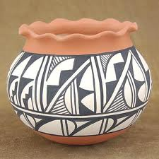
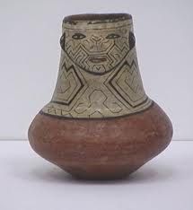
Pottery

Slide 10
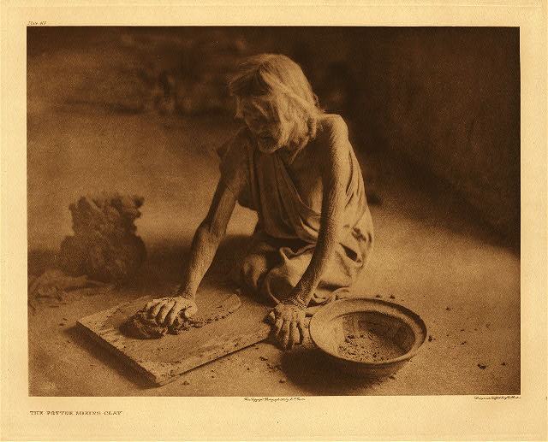
Potter Mixing Clay

Slide 11
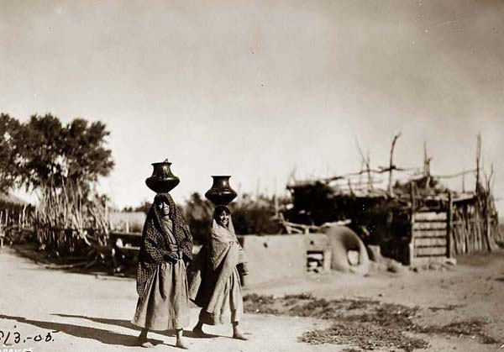

Slide 12
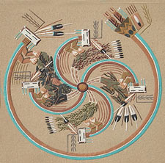
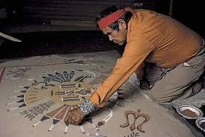
Sand paintings, as created by Navajo Indians, were not made to be an "art object," but rather were made as part of an elaborate healing ritual or ceremony. The artist, or in the Navajo context, the medicine man, would use naturally colored grains of sand, and pour them by hand to create these elaborate "paintings."

Slide 13
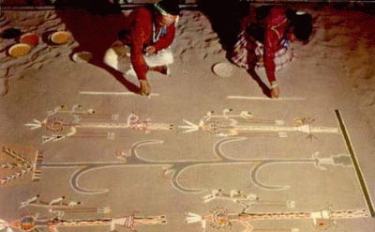
Once completed, the person that needed healing was asked to sit on top of the sand painting, which was supposed to act as a portal so that the healing spirits could come through the painting and heal the patient. Once the healing ceremony was over, then the painting was believed to have removed the illness from the patient, and therefore had the illness contained within it, so at that point the painting was destroyed.

Slide 14
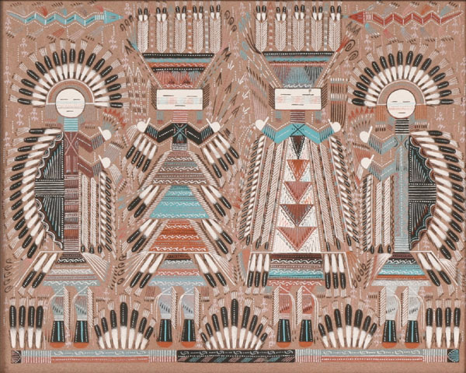
Sand Art

Slide 15
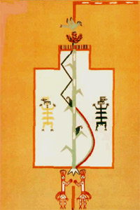
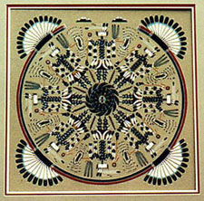

Slide 16
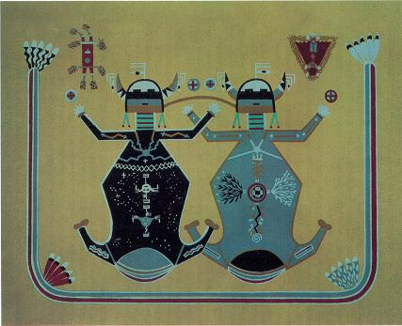

Slide 17
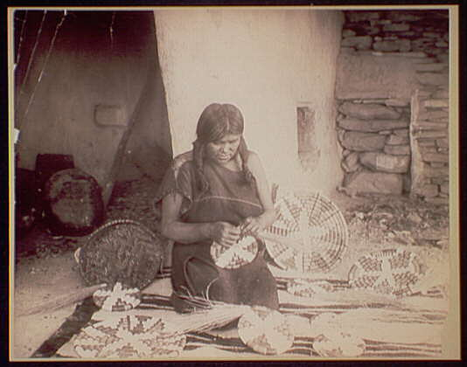
Baskets

Slide 18
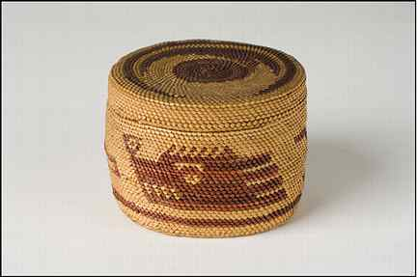
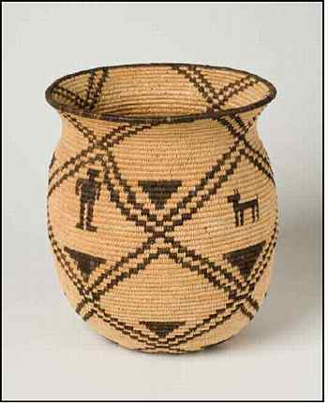
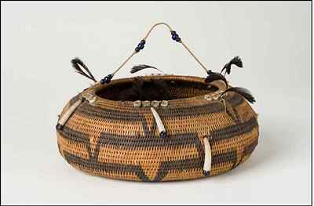
Basket making preceded pottery making, so baskets that were used for cooking were lined with clay, and water vessels were covered with pine pitch.

Slide 19
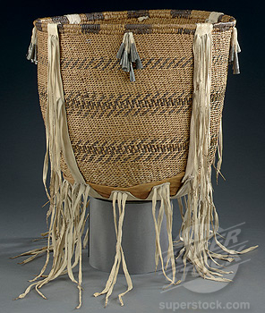
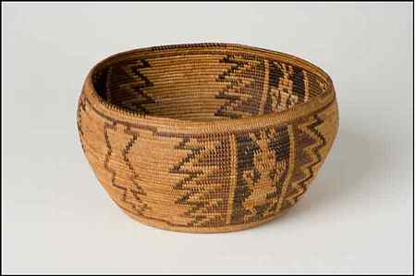
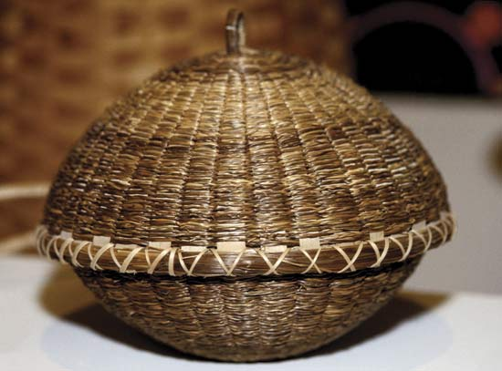
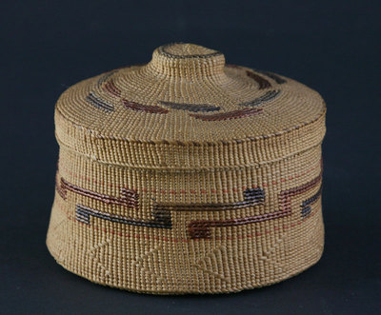

Slide 20
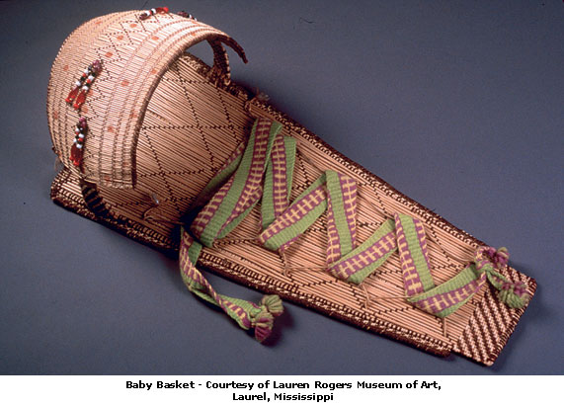

Slide 21
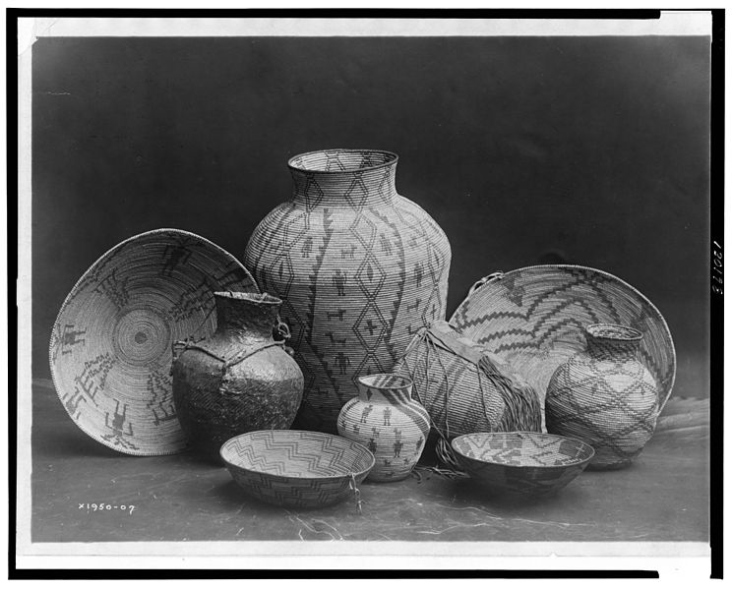

Slide 22
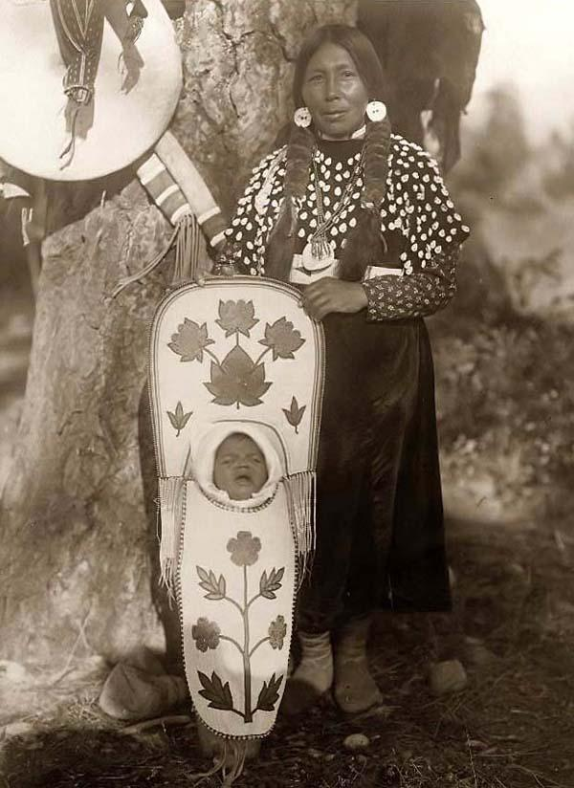

Slide 23
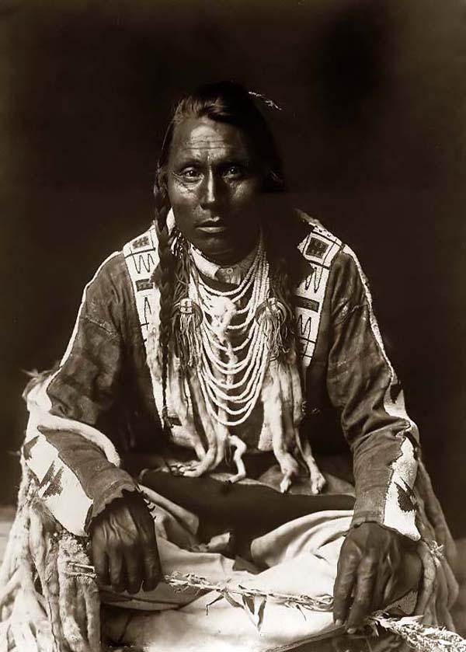

Slide 24
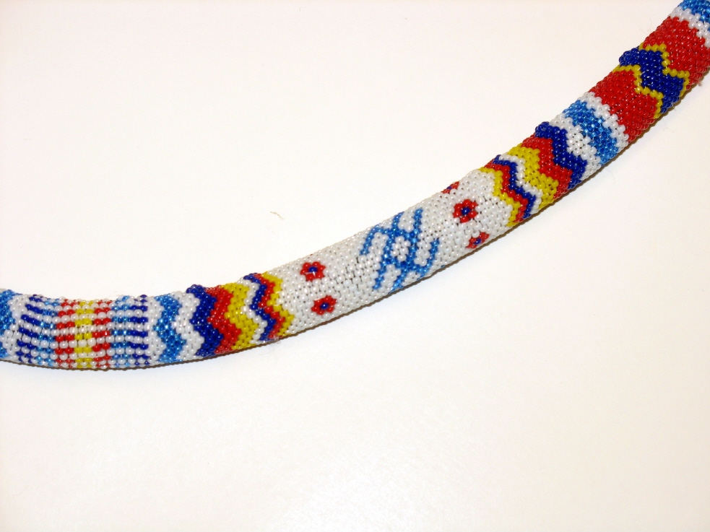
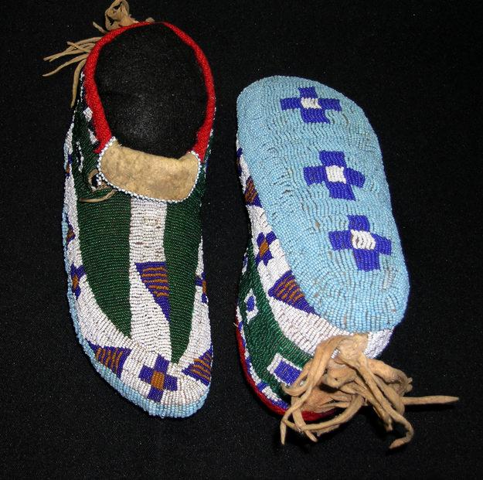
Bead Work

Slide 25
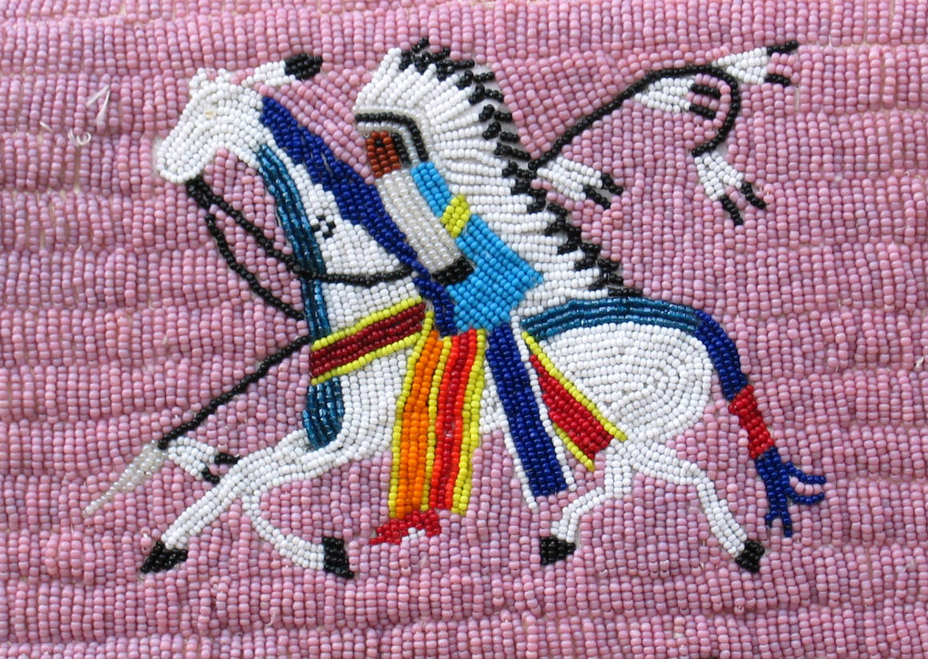
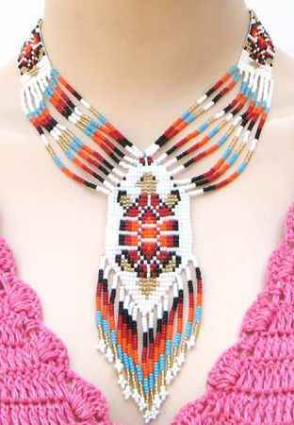
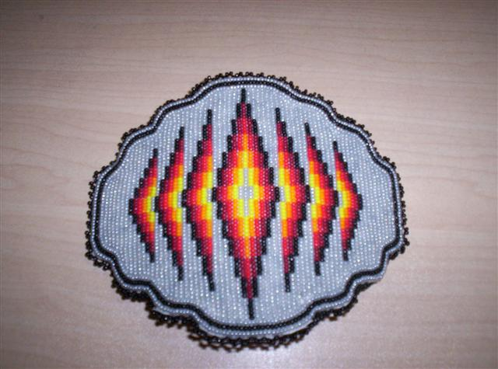

Slide 26
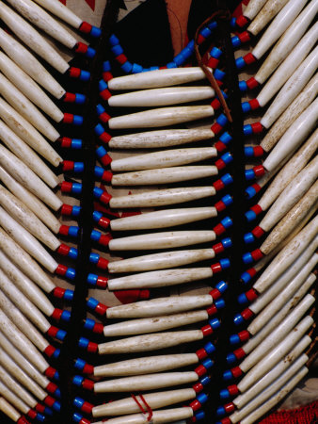
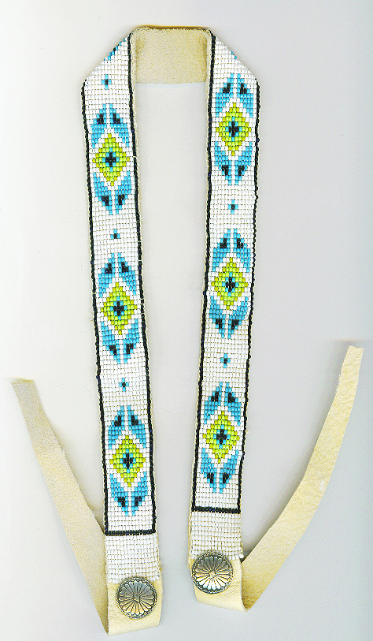

Slide 27
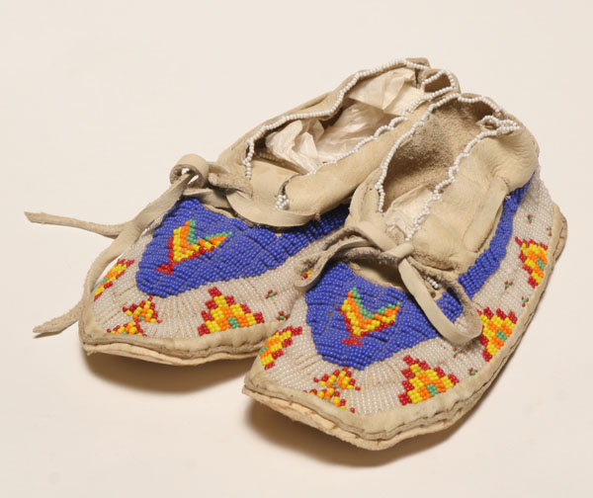
Beadwork is an art form that has a long tradition in Native American cultures. The use of glass beads by Native Americans began after contact with Europeans. It has been suggested exposure to glass beads first occurred with Christopher Columbus.

Slide 28
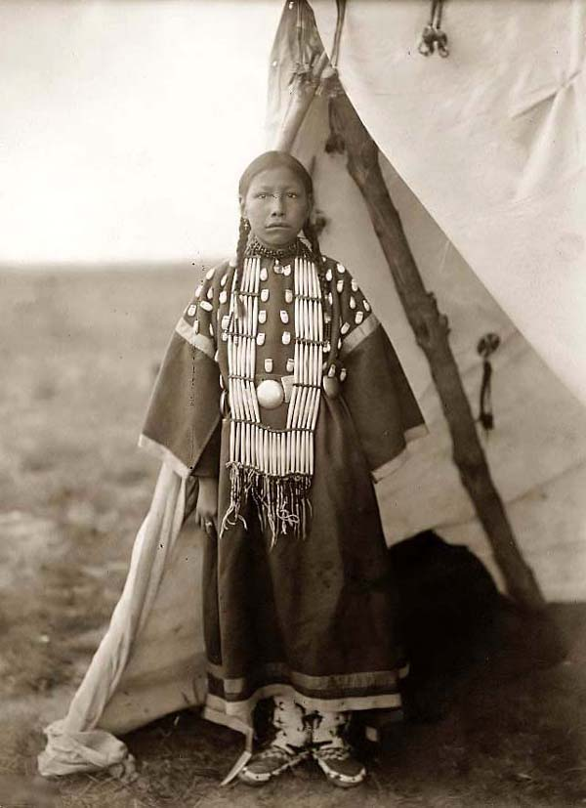

Slide 29
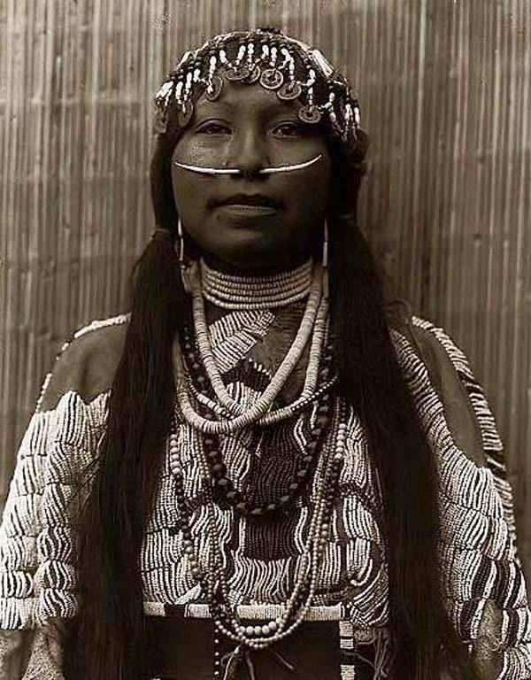

Slide 30
Totem Poles
Notes:
Totem

