Slide 1
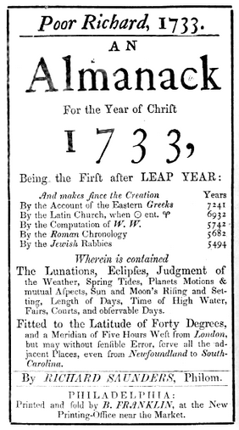
Mr. Smith’s Class
Presents
Poor Richard’s Almanac
2014

Slide 2
Original Excerpt:
Illustration:
Paraphrased Meaning:

Slide 3
Original Excerpt:
Illustration:
Paraphrased Meaning:

Slide 4
Original Excerpt:
Illustration:
Paraphrased Meaning:

Slide 5
Original Excerpt:
Illustration:
Paraphrased Meaning:

Slide 6
Original Excerpt:
Illustration:
Paraphrased Meaning:

Slide 7
Original Excerpt:
Illustration:
Paraphrased Meaning:

Slide 8
Original Excerpt:
Illustration:
Paraphrased Meaning:

Slide 9
Original Excerpt:
Illustration:
Paraphrased Meaning:

Slide 10
Original Excerpt:
Illustration:
Paraphrased Meaning:

Slide 11
Original Excerpt:
Illustration:
Paraphrased Meaning:

Slide 12
Original Excerpt:
Illustration:
Paraphrased Meaning:

Slide 13
Original Excerpt:
Illustration:
Paraphrased Meaning:

Slide 14
Original Excerpt:
Illustration:
Paraphrased Meaning:

Slide 15
Original Excerpt:
Illustration:
Paraphrased Meaning:

Slide 16
Original Excerpt:
Illustration:
Paraphrased Meaning:

Slide 17
Original Excerpt:
Illustration:
Paraphrased Meaning:

Slide 18
Original Excerpt:
Illustration:
Paraphrased Meaning:

Slide 19
Original Excerpt:
Illustration:
Paraphrased Meaning:

Slide 20
Original Excerpt:
Illustration:
Paraphrased Meaning:

Slide 21
Original Excerpt:
Illustration:
Paraphrased Meaning:

Slide 22
Original Excerpt:
Illustration:
Paraphrased Meaning:

Slide 23
Original Excerpt:
Illustration:
Paraphrased Meaning:

Slide 24
Original Excerpt:
Illustration:
Paraphrased Meaning:

Slide 25
Original Excerpt:
Illustration:
Paraphrased Meaning:

Slide 26
Original Excerpt:
Illustration:
Paraphrased Meaning:

Slide 27
Original Excerpt:
Illustration:
Paraphrased Meaning:

Slide 28
Original Excerpt:
Illustration:
Paraphrased Meaning:

Slide 29
Original Excerpt:
Illustration:
Paraphrased Meaning:

Slide 30
Original Excerpt:
Illustration:
Paraphrased Meaning:

Slide 31
Original Excerpt:
Illustration:
Paraphrased Meaning:

Slide 32
Original Excerpt:
Illustration:
Paraphrased Meaning:

