Slide 1
Powerful Questioning
Michelle Wagner

Slide 2
Question

Slide 3
Powerful Questions
Planned
Encourage Higher Level Thinking
Don’t Let Them Off The Hook
Probing
Clarifying
Wait Time

Slide 4
Most Questions
are done to learners.
are asked by the teacher.
occur at the end of the learning process.
are not used for formative purposes.
have a right answer.
(Vorenkamp, 2013)

Slide 5
Consider This…
Teachers ask up to 2 questions every minute.
up to 400 in a day
around 70,000 a year
2-3 million over their career
Questioning accounts for up to a third of all teaching time.
(Hastings, 2003)
Notes:
If you have been teaching for 14 years, you are probably getting ready to ask your millionth question.
The only thing we spend more time doing than questioning is explaining…

Slide 6
Consider This…
Most questions are answered in less than a second.
Research tells us that increasing the wait time improves the number and quality of the responses –
3 seconds for a lower-order question
10+ seconds for a higher-order question
(Hastings, 2003)
Notes:
That's the average time teachers allow between posing a question and accepting an answer, throwing it to someone else, or answering it themselves

Slide 7
When a teacher increases wait time:
Student responses will increase in length & accuracy.
More students will volunteer answers.

Slide 8
When a teacher increases wait time:
More students will challenge and/or expand on the ideas of others.
Students offer more alternative answers.
Students ask more questions of one another.

Slide 9
When a teacher increases wait time:
His/Her questioning varies.
More higher level questions are asked.
Increases the quality of the questions.

Slide 10
When a teacher increases wait time:
More follow-up questions will be asked.
It’s easier to see misconceptions or learning within the minds of the students.
Takes learning to the next level by focusing questions on deepening understanding.

Slide 11
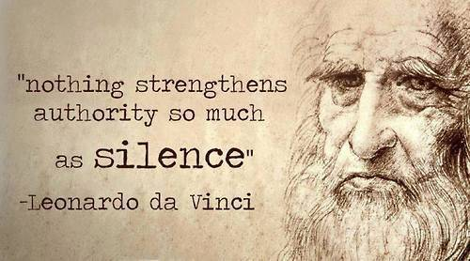

Slide 12
Hmmmm…

Slide 13
Current Questioning Realities
Most of the time students are recalling facts or explaining procedures.
Roughly 20% ask students to use a thinking skill above the knowledge level.
Most teachers believe they are teaching through their questions.

Slide 14
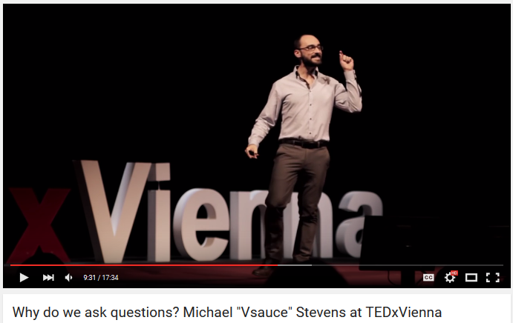
Cultivators Of Curiosity
Notes:
https://www.youtube.com/watch?v=u9hauSrihYQ

Slide 15
Show Me The Research
Instruction which includes questioning during the lesson produces more achievement gains.
Students perform better on lower level test questions when previously asked as recitation questions.
Kathleen Cotton
School Improvement Research Series

Slide 16
Show Me The Research
Lower level questions presented orally result in more learning than requiring written responses.
Questions which focus student attention on important, relevant elements of a lesson result in greater comprehension.
Kathleen Cotton
School Improvement Research Series

Slide 17
Show Me The Research
Asking questions frequently during class discussions is positively related to learning facts.
Older, more interested students need questions posed before a lesson
Kathleen Cotton
School Improvement Research Series
Notes:
Very young children and poor readers tend to focus only on material that will help them
answer questions if these are posed before the lesson is presented.

Slide 18
“To question well is to teach well. In the skillful use of the question more than anything else lies the fine art of teaching; for in it we have the guide to clear and vivid ideas, the quick spur to imagination, the stimulus to thought, the incentive to action.”
—Charles Degarmo
Notes:
1911 - De Garmo was born in Wisconsin. He graduated from Illinois State Normal University. He served as president of Swarthmore College from 1891–1898 and then joined the education faculty at Cornell University.^{[3]}
De Garmo was a prolific author of more than one hundred articles and books about educational theory and practice

Slide 19
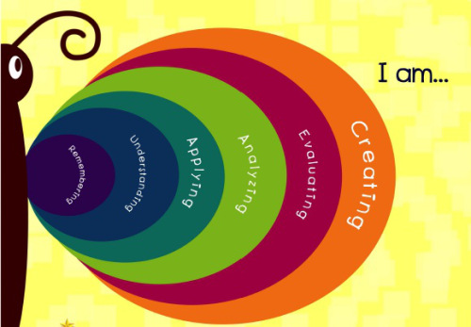
Creating Powerful Questions:
Blooming Butterfly

Slide 20
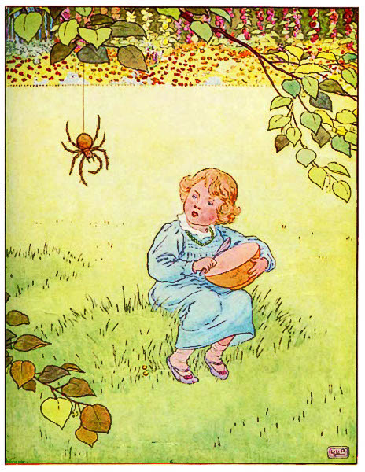
Give It A Try…
Little Miss Muffet
Little Miss Muffet Sat on a tuffet, Eating her curds and whey; Along came a spider, Who sat down beside her And frightened Miss Muffet away.
Notes:
Write 6 questions for this text, one at each level of Bloom

Slide 21
Improving Questioning Procedure
Randomly call on students.
Vary the question type.
Plan questions ahead of time.
Stick Pick
There’s an App for that…

Slide 22
Improving Question Quality
Focus on the concepts critical for mastering the learning target.
Engage students in the learning process.
Build logically and link to prior knowledge.
Encourage higher level thinking.
Nurture new insights.

Slide 23
When we use powerful questions…
We stimulate reasoning skills.
We help students make connections.
We encourage the application of knowledge.
We assess learning
We can use this to guide instruction.
We increase learning!

Slide 24
Our Goal

Slide 25
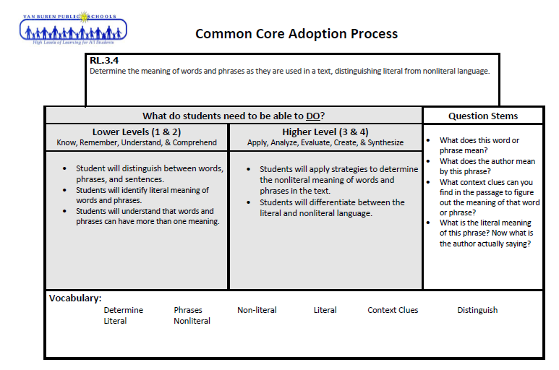
Our Goal
Create Powerful Questions

